Slide 1
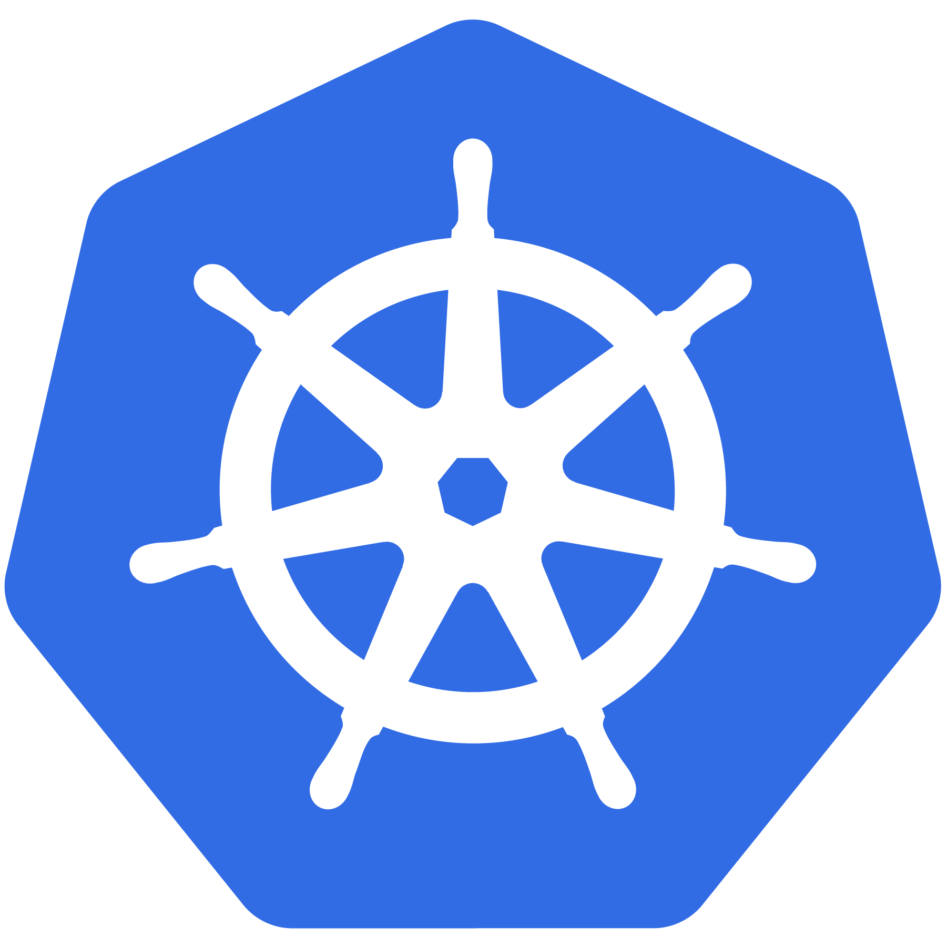
Kubernetes
An Introduction
CC-BY 4.0
Kubernetes v1.15 07/2019

Slide 2

Before We Begin
Requirements:
Minikube: https://github.com/kubernetes/minikube
Virtualbox*: https://www.virtualbox.org/wiki/Downloads
kubectl: https://kubernetes.io/docs/tasks/tools/install-kubectl/
k8s-intro-tutorials repo: https://github.com/mrbobbytables/k8s-intro-tutorials

Slide 3
Before We Begin
Go here for install instructions
https://goo.gl/1HV3Tu

Slide 4
Kubernetes
An Introduction
CC-BY 4.0
Kubernetes v1.15 07/2019

Slide 5



$ whoami - Bob
Bob Killen
rkillen@umich.edu
Senior Research Cloud Administrator
CNCF Ambassador
Github: @mrbobbytables
Twitter: @mrbobbytables

Slide 6

$ whoami - Jeff
Jeffrey Sica
jsica@umich.edu
Senior Research Database Administrator
Github: @jeefy
Twitter: @jeefy
Notes:
Delete me if I’m not there.

Slide 7
Project
Overview
Notes:
Quick overview of the project and what Kubernetes it
Note: This is currently for v1.12

Slide 8

What Does “Kubernetes” Mean?
Greek for “pilot” or
“Helmsman of a ship”
Image Source
Notes:
The first question always asked
There is also the abbreviation of K8s -- K, eight letters, s

Slide 9
What is Kubernetes (K8s)?
Project that was spun out of Google as an open source container orchestration platform.
Built from the lessons learned in the experiences of developing and running Google’s Borg and Omega.
Designed from the ground-up as a loosely coupled collection of components centered around deploying, maintaining and scaling workloads.
Notes:
There’s a phrase called Google-scale. This was developed out of a need to scale large container applications across Google-scale infrastructure
borg is the man behind the curtain managing everything in google
Kubernetes is loosely coupled, meaning that all the components have little knowledge of each other and function independently.
This makes them easy to replace and integrate with a wide variety of systems

Slide 10
What Does Kubernetes do?
Known as the linux kernel of distributed systems.
Abstracts away the underlying hardware of the nodes and provides a uniform interface for workloads to be both deployed and consume the shared pool of resources.
Works as an engine for resolving state by converging actual and the desired state of the system.
Notes:
linux kernel of distributed systems
Sort of like a hypervisors, in that it abstracts away the underlying host resources and shares them in a normalized way.
the underlying substrate or platform to build your applications and tools on top of
Think of Kubernetes like a higher-level language for your application architecture.
you describe what you need and it tries to resolve it
with that in mind, it acts as an engine to resolve state using the abstracted resources to deploy and manage your application.
It is declarative, and not imperative. You tell it or “declare” what you want, and it figures out the rest.
imperative you tell something every step you want it to do
declarative you tell it what you want it to be, and it figures it out
e.g. ‘I want 5 instances of x’ and it just does it, if something dies, it brings it back to get to 5

Slide 11
Decouples Infrastructure and Scaling
All services within Kubernetes are natively Load Balanced.
Can scale up and down dynamically.
Used both to enable self-healing and seamless upgrading or rollback of applications.
Notes:
A lot of key components are batteries-included

Slide 12
Self Healing
Kubernetes will ALWAYS try and steer the cluster to its desired state.
Me: “I want 3 healthy instances of redis to always be running.”
Kubernetes: “Okay, I’ll ensure there are always 3 instances up and running.”
Kubernetes: “Oh look, one has died. I’m going to attempt to spin up a new one.”
(The instance will have a new IP and likely be on a different host, but Kubernetes gives the primitives for us to ‘not care’ about that.)
Notes:
The instance will have a new IP and likely be on a different host, but Kubernetes gives the primitives for us to ‘not care’ about that.

Slide 13
What can Kubernetes REALLY do?
Autoscale Workloads
Blue/Green Deployments (zero-downtime upgrade to an existing application. The “Blue” version is the currently running copy of the application and the “Green” version is the new version. Once the green version is ready, traffic is rerouted to the new version)
Fire off jobs and scheduled cronjobs
Manage Stateless and Stateful Applications
Provide native methods of service discovery
Easily integrate and support 3rd party apps
Notes:
Everything here requires some level of configuration

Slide 14
Most Importantly...
Use the SAME API across bare metal and EVERY cloud provider!!!
Notes:
Single biggest value-add Kubernetes can offer

Slide 15

Who “Manages” Kubernetes?
The CNCF is a child entity of the Linux Foundation and operates as a vendor neutral governance group.
Notes:
CNCF is a sub-foundation of the Linux Foundation
A vendor neutral entity to manage “cloud native” projects
Projects that are “cloud native” generally focus on:
containers
dynamic orchestration
enable “microservice” deployment methodologies
can be logging, monitoring, containerizers etc
Kubernetes was the first project under the CNCF, and the first to be “graduated”

Slide 16

Project Stats
Over 55,000 stars on Github
2000+ Contributors to K8s Core
Most discussed Repository by a large margin
70,000+ users in Slack Team
07/2019
Notes:
Very active project
49k starts on github
2000+ contributors to main core repo
most discussed repo on github
massive slack team with 60k+ users

Slide 17
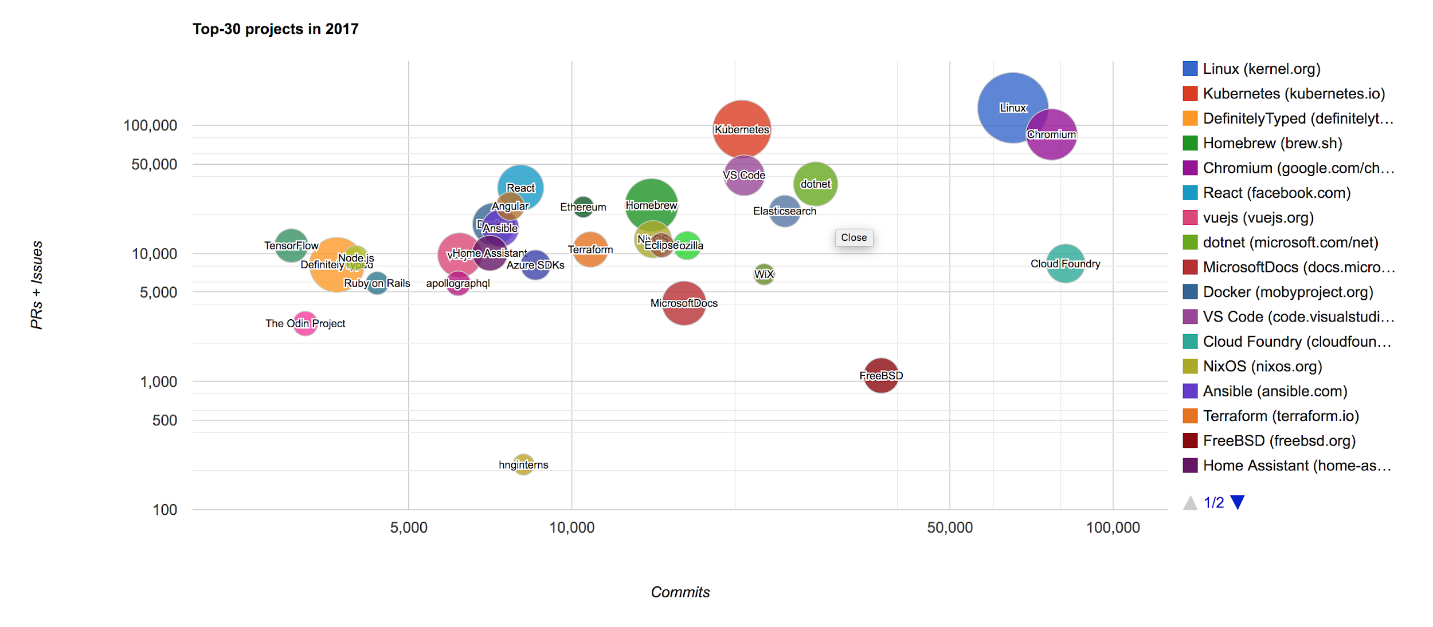
Project Stats
Notes:
Graphic is a little out of date at this point, but for the most part still holds true
Also one of the largest open source projects based on commits and PRs.

Slide 18
A Couple
Key Concepts...
Notes:
There are a few small things we should mention
It’s kind of a chicken and egg problem. But we need to talk about these before the stuff that supports and extends it

Slide 19
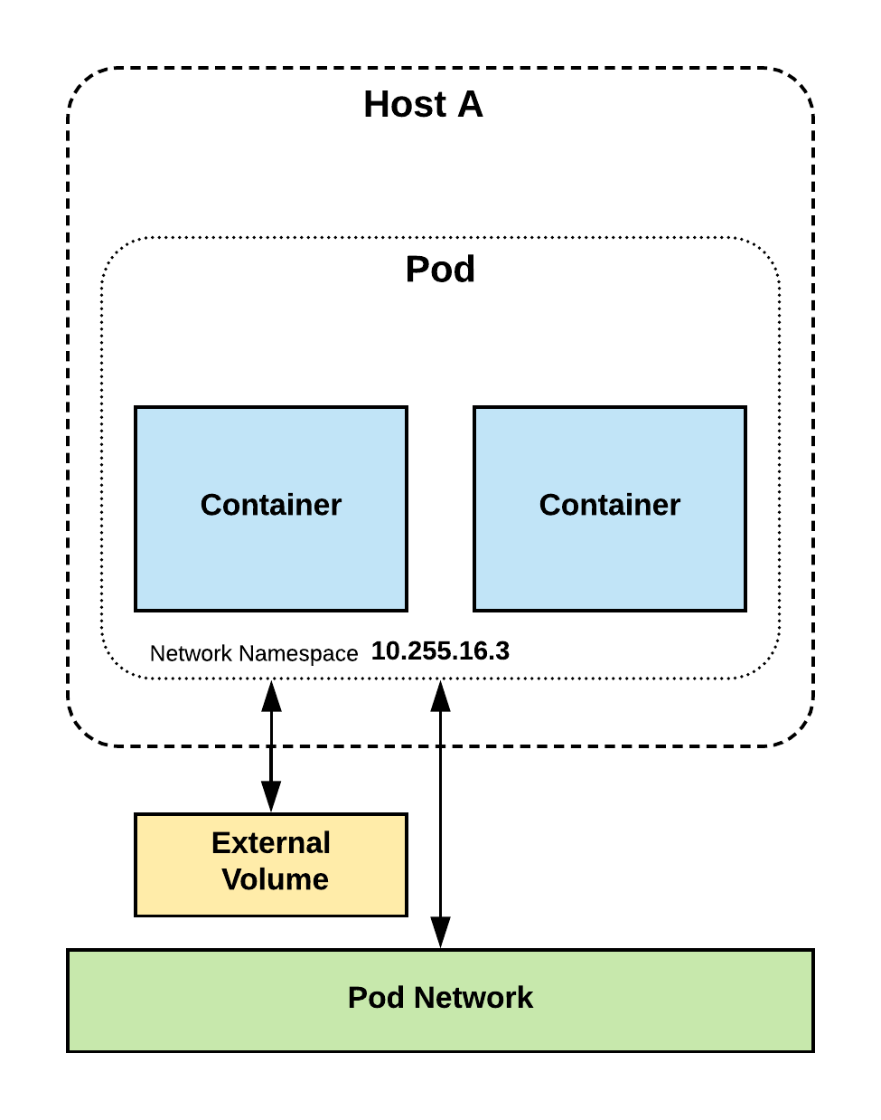
Pods
Atomic unit or smallest “unit of work”of Kubernetes.
Pods are one or MORE containers that share volumes, a network namespace, and are a part of a single context.

Slide 20
Pods
They are
also
Ephemeral!
Ephemeral: being or relating to something temporary therefore liable to change or be lost, unless copied to permanent storage
Notes:
Higher level objects manage replicas, fault tolerance etc.

Slide 21
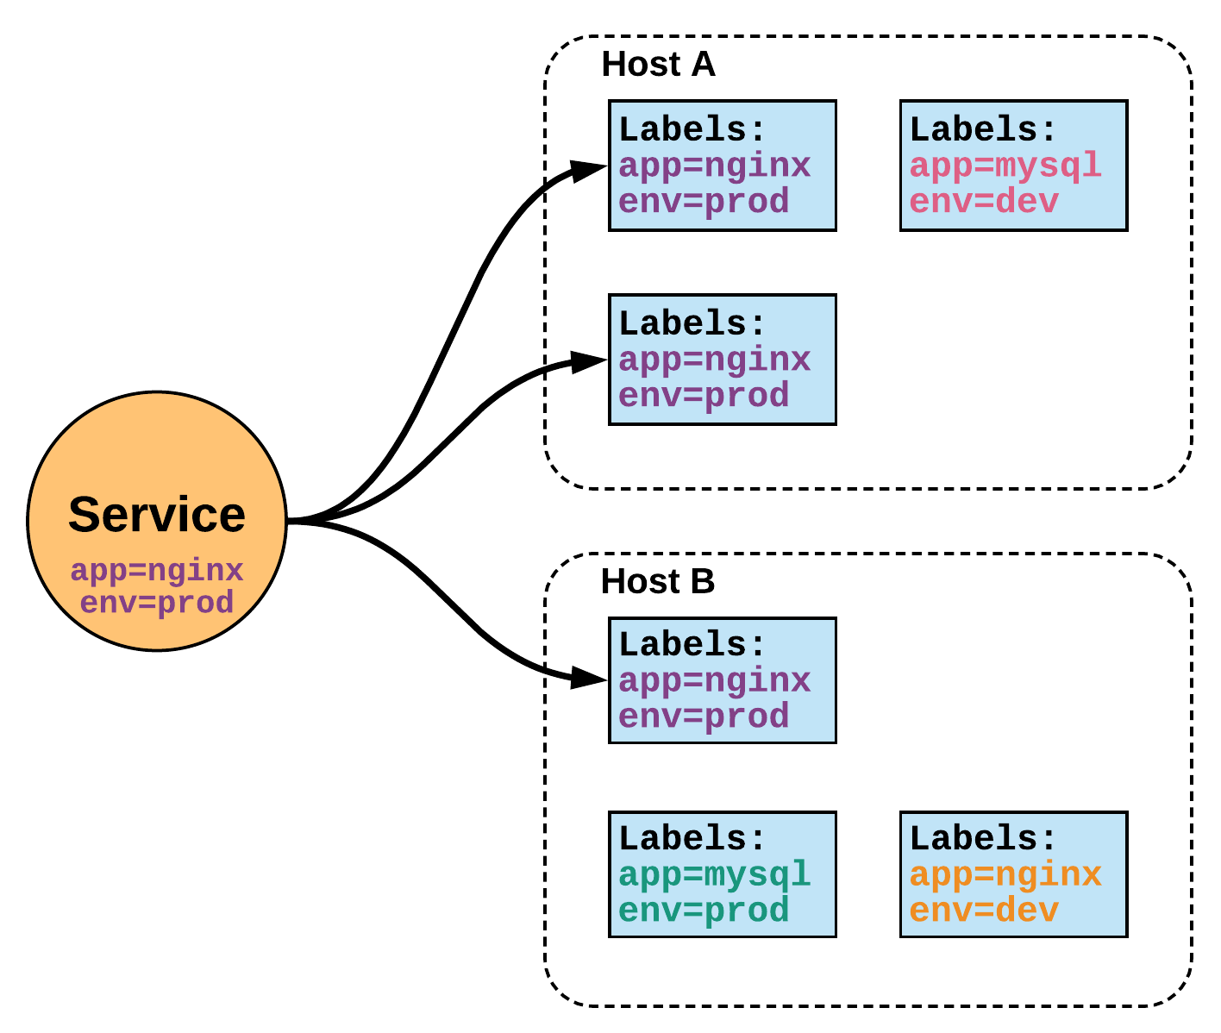
Services
Unified method of accessing the exposed workloads of Pods.
A service is an internal load balancer to its pod(s)
Durable resource
static cluster IP
static namespaced DNS name
Notes:
While this may seem like a technical definition, in practice it can be viewed more simply:
A service is an internal load balancer to your pod(s). You have 3 HTTP pods scheduled? Create a service, reference the pods, and (internally) it will load balance across the three.

Slide 22
Services
Unified method of accessing the exposed workloads of Pods.
Services: persistent objects used to reference ephemeral resources
Durable resource
static cluster IP
static namespaced DNS name
NOT Ephemeral!
Notes:
Services are persistent objects used to reference ephemeral resources

Slide 23
Architecture
Overview
Notes:
Get right into the meat of the internals.

Slide 24
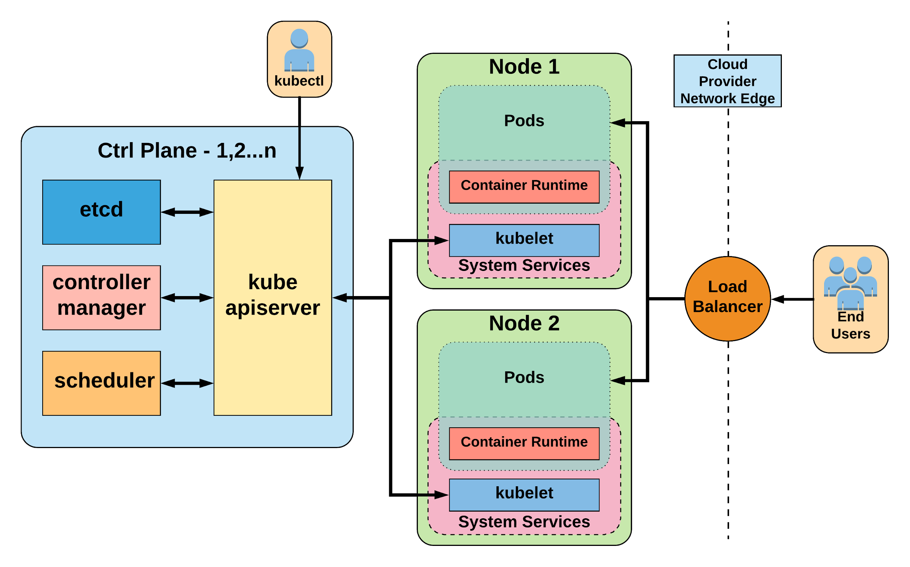
Worker Nodes
Master Controller
Potentially multiple replicas of master controller
container runtime (container engine):
software that runs containers on a host OS.
Notes:
General High Level Architecture Overview
There is 1-n number of masters or control plane servers, usually deployed in 1,3,5,7 configurations
Up to 5000 “worker nodes”
This is what it’s certified to and E2E tests are built for

Slide 25
Control Plane Components
Architecture Overview

Slide 26
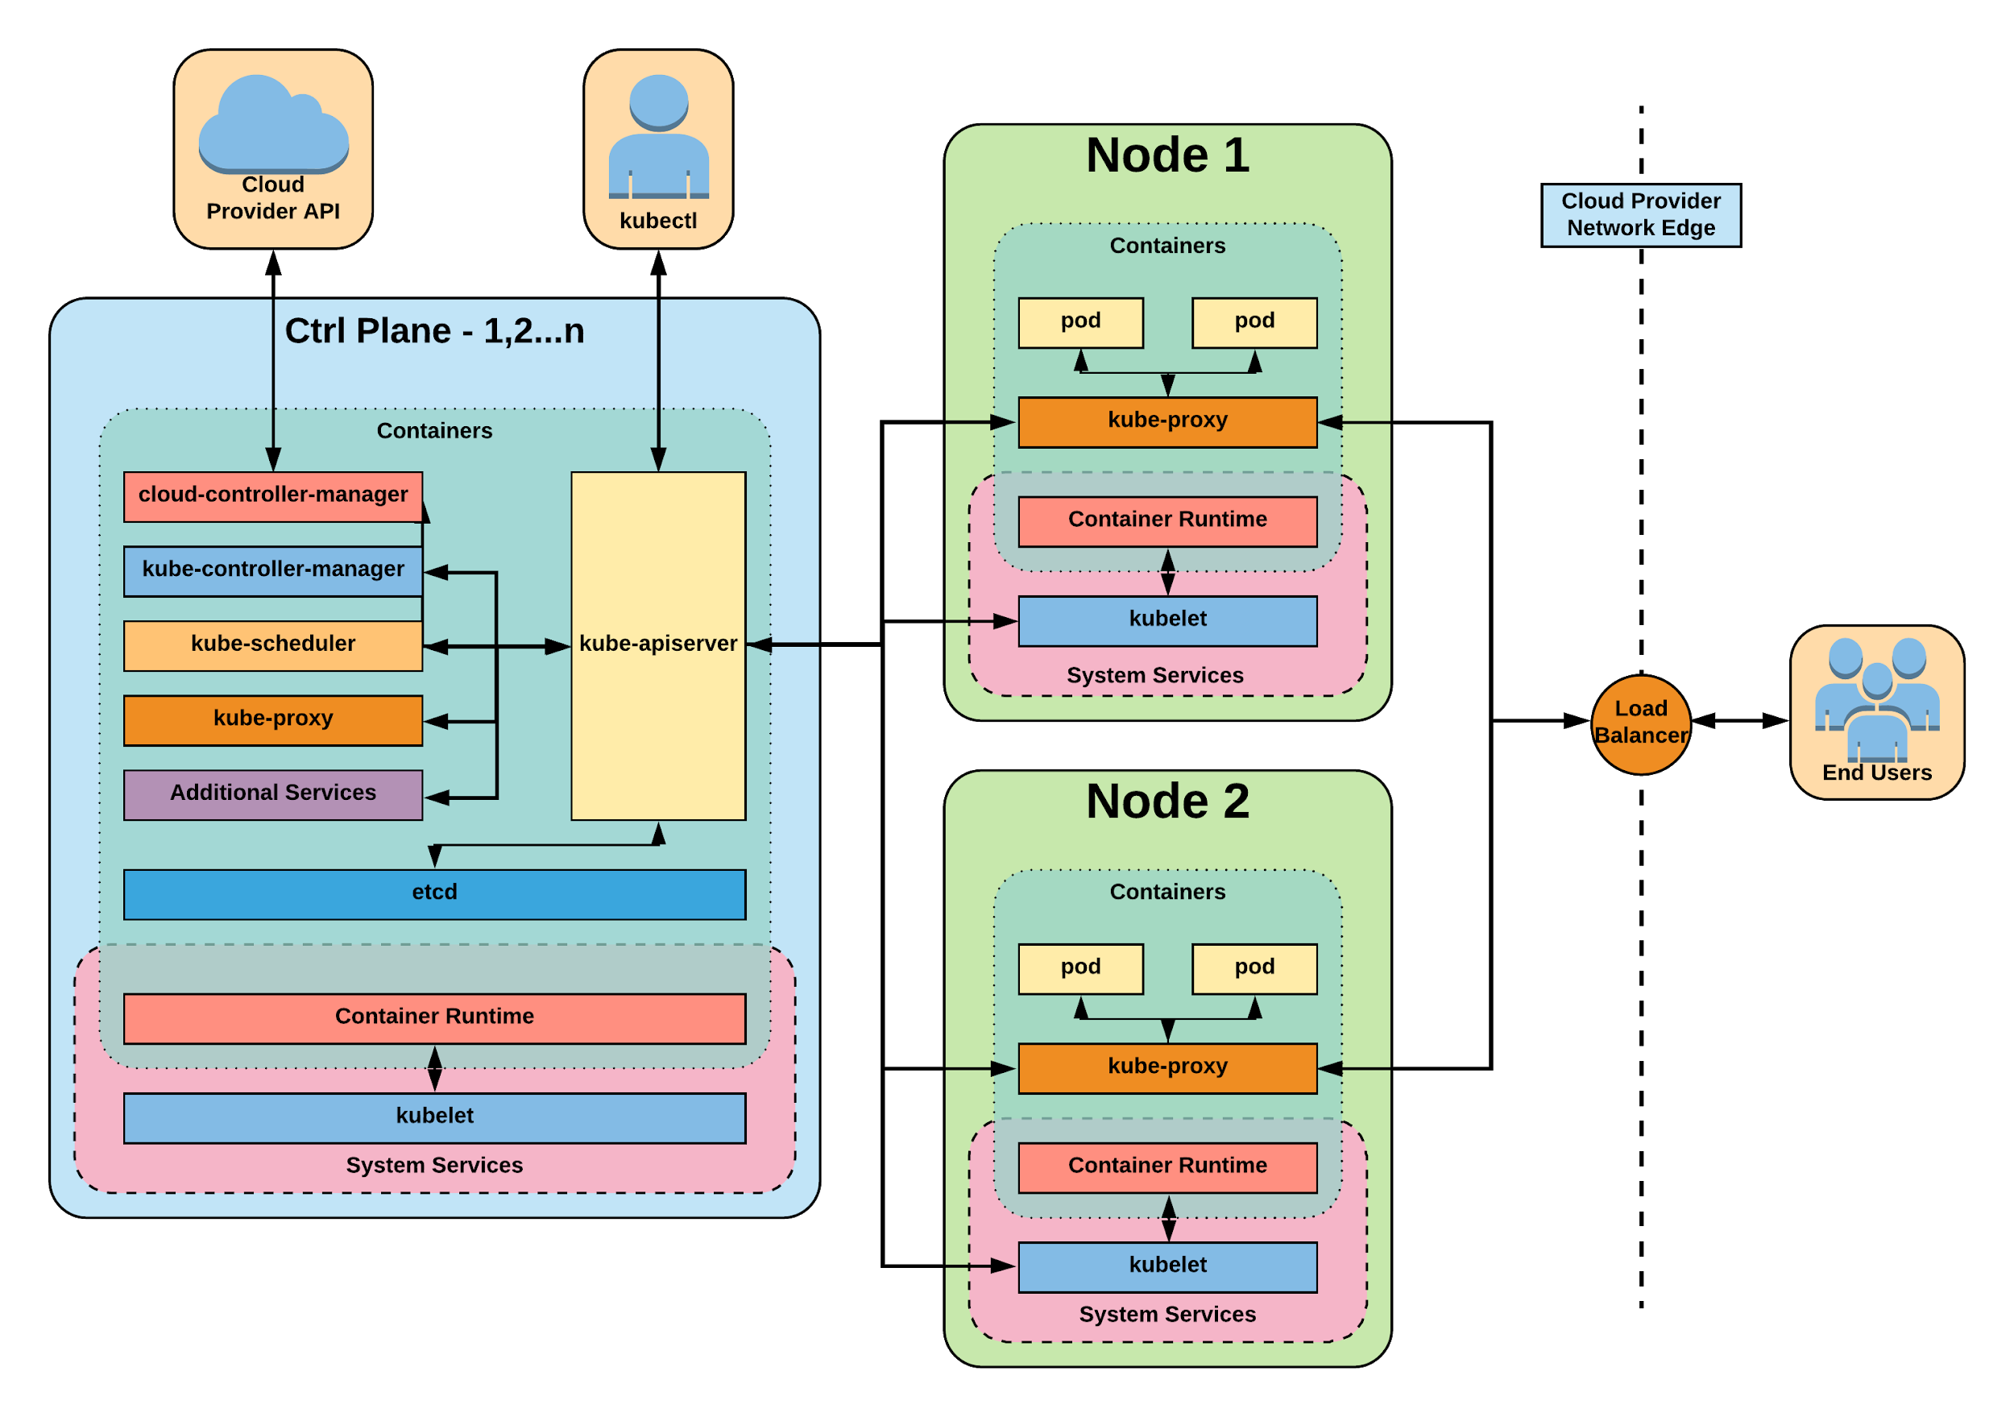
Control Plane Components
kube-apiserver - frontend
Etcd – storage backend
kube-controller-manager
- home of the core controller
kube-scheduler
- handles placement
Notes:
Kube-apiserver
Gate keeper for everything in kubernetes
EVERYTHING interacts with kubernetes through the apiserver
Etcd
Distributed storage back end for kubernetes
The apiserver is the only thing that talks to it
Kube-controller-manager
The home of the core controllers
kube-scheduler
handes placement

Slide 27
kube-apiserver
Provides a forward facing REST interface into the kubernetes control plane and datastore.
All clients and other applications interact with kubernetes strictly through the API Server.
Acts as the gatekeeper to the cluster by handling authentication and authorization, request validation, mutation, and admission control in addition to being the front-end to the backing datastore.
Notes:
provides forward facing REST interface into k8s itself
everything, ALL components interact with each other through the api-server
handles authn, authz, request validation, mutation and admission control and serves as a generic front end to the backing datastore

Slide 28

etcd
etcd acts as the cluster datastore.
Purpose in relation to Kubernetes is to provide a strong, consistent and highly available key-value store for persisting cluster state.
Stores objects and config information.
Notes:
is the backing datastore
extremely durable and highly available key-value store
was developed originally by coreos now redhat
however it is in the process of being donated to the CNCF

Slide 29
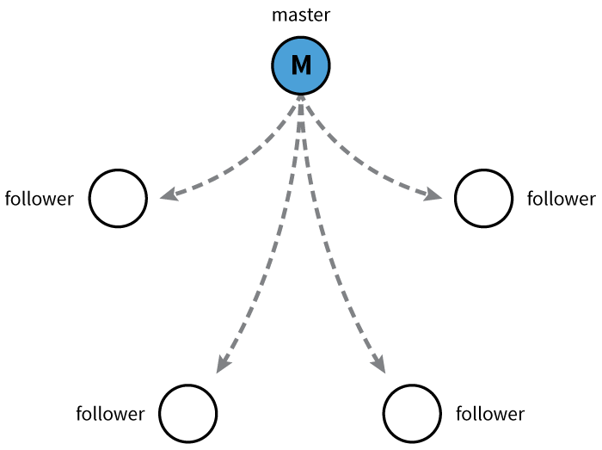
etcd
Uses “Raft Consensus” among a quorum of systems to create a fault-tolerant consistent “view” of the cluster.
https://raft.github.io/
Image Source
Notes:
provides HA via raft
requires quorum of systems
Typically aim for 1,3,5,7 control plane servers

Slide 30
kube-controller-manager
Serves as the primary daemon that manages all core component control loops.
Monitors the cluster state via the apiserver and steers the cluster towards the desired state.
List of core controllers: https://github.com/kubernetes/kubernetes/blob/master/cmd/kube-controller-manager/app/controllermanager.go#L344
Notes:
Its the director behind the scenes
The thing that says “hey I need a few more pods spun up”
Does NOT handle scheduling, just decides what the desired state of the cluster should look like
e.g. receives request for a deployment, produces replicaset, then produces pods

Slide 31
kube-scheduler
Verbose policy-rich engine that evaluates workload requirements and attempts to place it on a matching resource.
Default scheduler uses bin packing.
Workload Requirements can include: general hardware requirements, affinity/anti-affinity, labels, and other various custom resource requirements.
Notes:
scheduler decides which nodes should run which pods
updates pod with a node assignment, nodes poll checking which pods have their matching assignment
takes into account variety of reqs, affinity, anti-affinity, hw resources etc
possible to actually run more than one scheduler
example: kube-batch is a gang scheduler based off LSF/Symphony from IBM

Slide 32
Node
Components
Architecture Overview

Slide 33
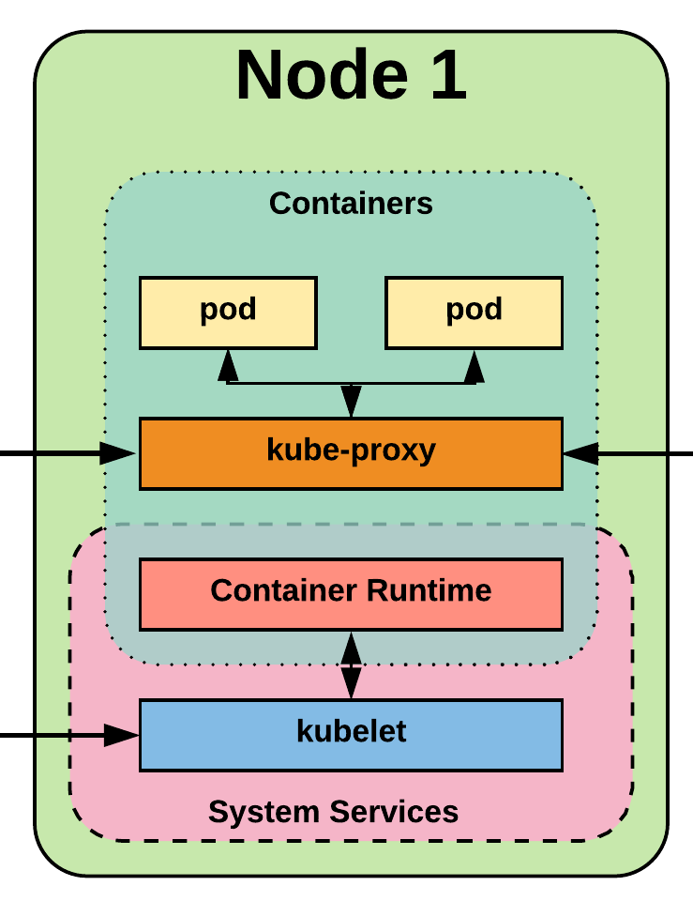
Node Components
kubelet
kube-proxy
Container Runtime Engine
Notes:
Kubelet
Agent running on every node, including the control plane
Kube-proxy
The network ‘plumber’ for Kubernetes services
Enables in-cluster load-balancing and service discovery
Container Runtime Engine
The containerizer itself - typically docker

Slide 34
kubelet
Acts as the node agent responsible for managing the lifecycle of every pod on its host.
workers: poll kube-apiserver looking for what they should run
Kubelet understands YAML container manifests. The YAML file can read from several sources:
file path
HTTP Endpoint
etcd watch acting on any changes
HTTP Server mode accepting container manifests over a simple API.
Notes:
the single host daemon required for a being a part of a kubernetes cluster
can read pod manifests from several different locations
workers: poll kube-apiserver looking for what they should run
masters: run the master services as static manifests found locally on the host

Slide 35
kube-proxy
Manages the network rules on each node: map and expose services
Performs connection forwarding or load balancing for Kubernetes cluster services.
Available Proxy Modes:
Userspace
iptables
ipvs (default if supported)
(ipvs: (IP Virtual Server): perf. enhancement to kube-proxy. IPVS on host - load balancer in front of cluster of real servers)
Notes:
kube-proxy is the plumber
creates the rules on the host to map and expose services
uses a combination of ipvs and iptables to manage networking/loadbalancing
ipvs is more performant and opens the door to a wider feature set (port ranges, better lb rules etc)

Slide 36
Container Runtime Engine
A container runtime -- a CRI (Container Runtime Interface) compatible application that executes and manages containers.
Containerd (docker)
Cri-o
Rkt
Kata (lightweight KVM wrapper)
Virtlet (VM CRI compatible runtime)
runC
Notes:
Kubernetes functions with multiple different containerizers
Interacts with them through the CRI - container runtime interface
CRI creates a ‘shim’ to talk between kubelet and the container runtime
cri-o is a cool one that allows you to run any oci compatible image/runtime in Kubernetes
kata is a super lightweight KVM wrapper

Slide 37

Kubernetes Controller
Notes:
The complete picture

Slide 38
Optional
Services
Architecture Overview
Notes:
“Optional” Services

Slide 39
cloud-controller-manager
Daemon that provides cloud-provider specific ( e.g., Google, AWS, Azure) knowledge and integration capability into the core control loop of Kubernetes.
Acts as the mediator for providing a number of functions – e.g., volumes, services.
The controllers include Node, Route, Service, and adds an additional controller to handle things such as PersistentVolume Labels.
Notes:
runs in the control plane
Google, amazon etc all have their own defaults for providing volumes and services to a cluster, this acts as the middle man

Slide 40
Cluster DNS
Provides Cluster Wide DNS for Kubernetes Services.
Built on top of CoreDNS
Notes:
CoreDNS is a single go-language binary with a slew of plugins and much better native kubernetes support
previously used kube-dns in 1.11 and earlier.
wrapper around dnsmasq with another container in the pod that manages its config

Slide 41
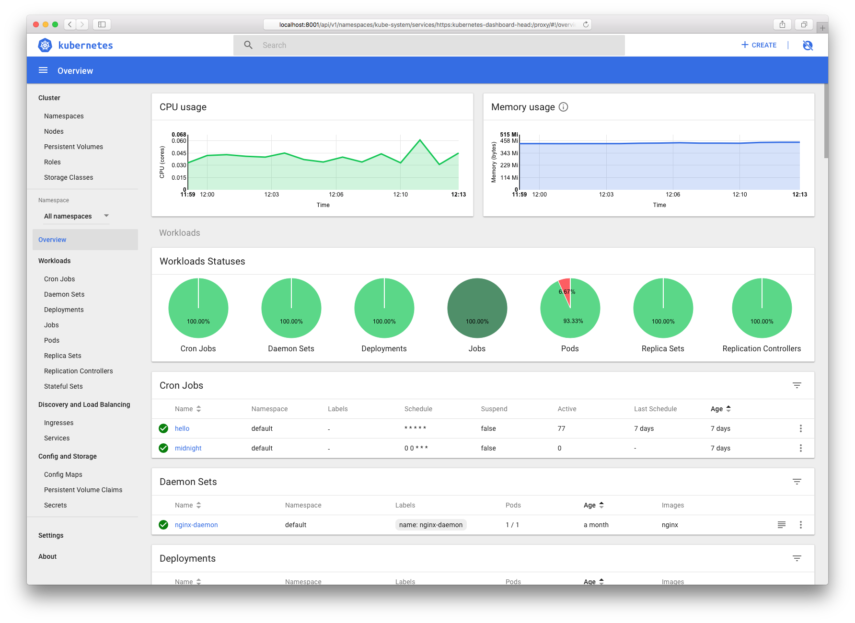
Kube Dashboard
A limited, general purpose web front end for the Kubernetes Cluster.
Notes:
Useful for quickly getting a picture of the cluster, but no substitute for cli or other tools

Slide 42
Heapster / Metrics API Server
Provides metrics for use with other Kubernetes Components.
Heapster (deprecated, removed)
Metrics API (current)
Notes:
Heapster has being deprecated but can be found in minikube addons
metrics api is taking over, also in minikube as an addon
used with horizontal pod autoscaler, kube-dashboard, kubectl etc

Slide 43
Networking
Architecture Overview
Notes:
Networking is where people tend to get confused, they think of it like Docker
The backing cluster network is a plugin, does not work just out of the box

Slide 44
Kubernetes Networking
Pod Network
every pod gets its own cluster wide unique IP, and makes use of the CNI plugin (can ping a pod IP)
Cluster-wide network used for pod-to-pod communication managed by a CNI (Container Network Interface) plugin.
Service Network
Services are a separate range of static non-routable virtual IPs that are used like an internal LB or static IP
Cluster-wide range of Virtual IPs managed by kube-proxy for service discovery.
Non-routable (can’t ping) static IP
Notes:
Unlike Docker, every pod gets its own cluster wide unique IP, and makes use of the CNI plugin
Services are a separate range of static non-routable virtual IPs that are used like an internal LB or static IP
Service IPs are special and can’t be treated like a normal IP, they are a ‘mapping’ stored and managed by kube-proxy
Pod IPs are pingable
Service IPs are not

Slide 45

Container Network Interface (CNI)
Pod networking within Kubernetes is plumbed via the Container Network Interface (CNI).
It functions as an interface between the container runtime (linux network namespace) and a network implementation plugin.
CNCF Project
Uses a simple JSON Schema.
Notes:
Covering this as its a requirement if bootstrapping your own cluster
Container runtime in this context is a linux network namespace
CNI runtime focuses solely on container lifecycle connectivity
add and delete network

Slide 46
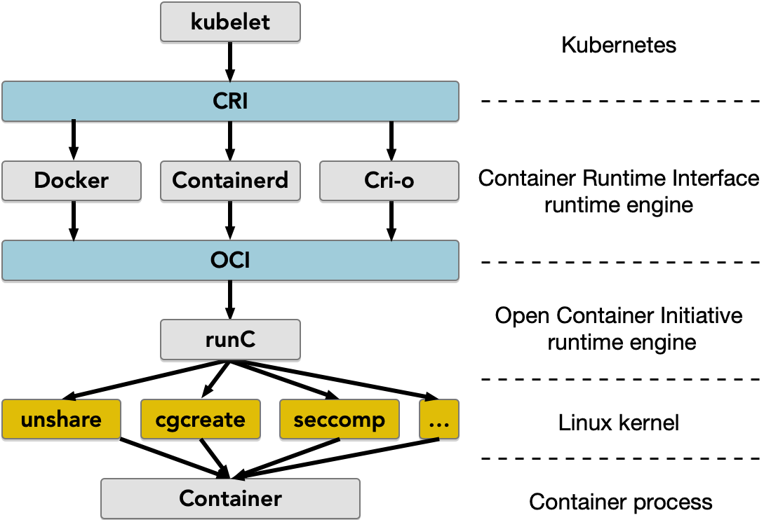
Container Networking in a Worker Pod in Kubernetes
"runc" - tool to create and run Linux containers provides core functionality for launching and managing containers.

Slide 47
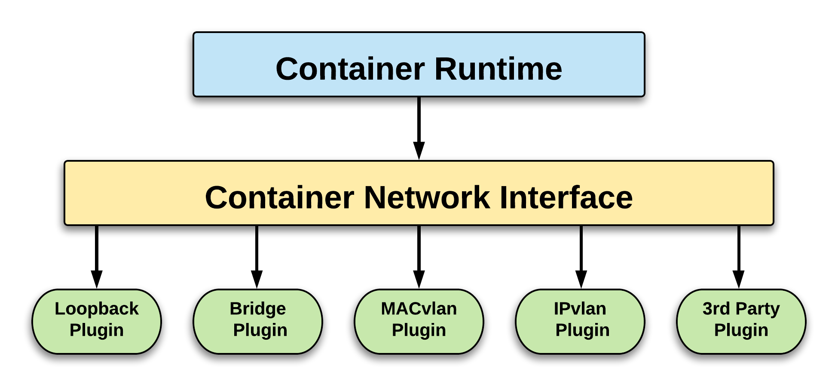
CNI Overview

Slide 48
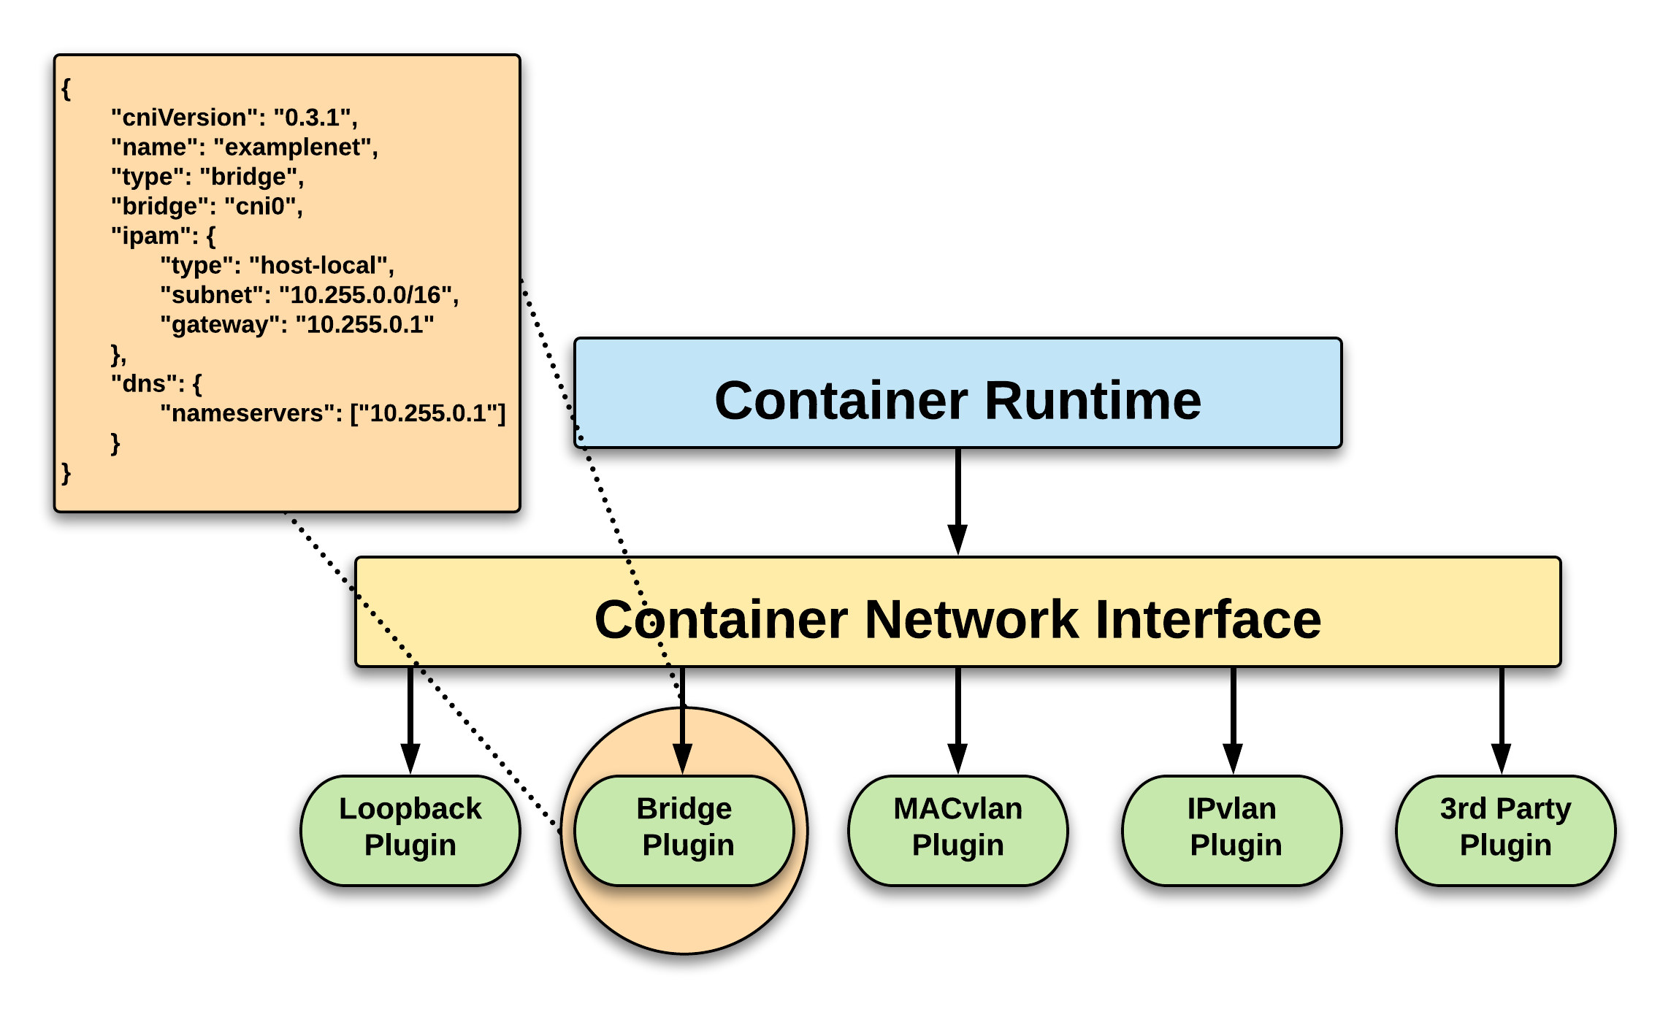
CNI Overview

Slide 49








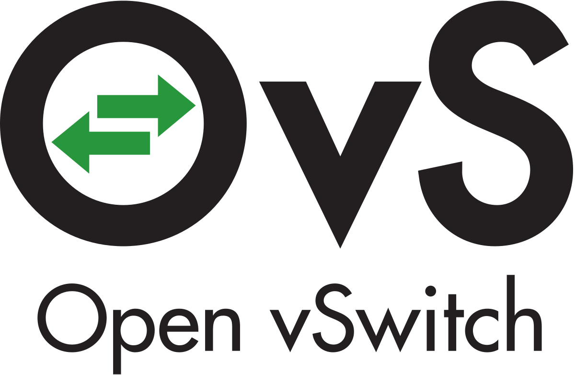



CNI Plugins
Amazon ECS
Calico
Cillium
Contiv
Contrail
Flannel
GCE
kube-router
Multus
OpenVSwitch
Romana
Weave
S. Qi, S. G. Kulkarni and K. K. Ramakrishnan, "Assessing Container Network Interface Plugins: Functionality,
Performance, and Scalability," in IEEE Transactions on Network and Service Management, March 2021
Notes:
Just a subset, circa Feb 2018

Slide 50
Fundamental Networking Rules
All containers within a pod can communicate with each other unimpeded.
All Pods can communicate with all other Pods without NAT.
All nodes can communicate with all Pods (and vice-versa) without NAT.
The IP that a Pod sees itself as - is the same IP that others see it as.
Notes:
Reminder to myself: Don’t expand on things on THIS SLIDE, use the next ones
Kubernetes adheres to these fundamental rules for networking

Slide 51
Fundamentals Applied
Container-to-Container
Containers within a pod exist within the same network namespace and share an IP.
Enables intrapod communication over localhost.
Pod-to-Pod
Allocated cluster unique IP for the duration of its life cycle.
Pods themselves are fundamentally ephemeral.
Notes:
Pods are groups of containers into a single manageable unit
Example: app container + a container within a pod that sends logs to another service
As such the containers share a network namespace
Pods are given a cluster unique IP for the duration of its lifecycle.
Think dhcp, a Pod will be given a static lease for as long as it’s around

Slide 52
Fundamentals Applied
Pod-to-Service Connectivity
managed by kube-proxy and given a persistent cluster unique IP (maps to n pods)
E.g., like a DNS name, or a LB, to point to containers supporting the service; exists beyond a Pod’s lifecycle.
External-to-Service
Handled by kube-proxy.
Works in cooperation with a cloud provider or other external entity (load balancer).
Notes:
Both pod-to-service and external-to-service connectivity relies on kube-proxy
For pod-to-service - kubernetes creates a cluster-wide IP that can map to n-number of pods
think like a dns name, or an LB to point to containers backing your service
External Connectivity relies on an external entity, a cloud provider or some other system in conjunction with kube-proxy to map out-of-cluster access to cluster services

Slide 53
Concepts
and
Resources
Notes:
Laying some groundwork

Slide 54
The API
and Object Model
Concepts and Resources

Slide 55

API Overview
The REST API is the true keystone of Kubernetes.
Everything within the Kubernetes is as an API Object.
Image Source
Notes:
API-Server is the keystone to Kubernetes
Every component communicates with it
Everything created within Kubernetes is an API object or resource
This is object-oriented application architecture

Slide 56
API Groups
Designed to make it extremely simple to both understand and extend.
An API Group is a REST compatible path that acts as the type descriptor for a Kubernetes object.
Referenced within an object as the apiVersion and kind.
Format:
/apis/<group>/<version>/<resource>
Examples:
/apis/apps/v1/deployments
/apis/batch/v1beta1/cronjobs
Notes:
Every object in kubernetes belongs to an API Group
The API Group is a REST compatible path that acts as the type descriptor for a Kubernetes object.
apiVersion is the version of the object we’re creating
kind is the specific type of object or resource being created

Slide 57
API Versioning
Three tiers of API maturity levels.
Also referenced within the object apiVersion.
Alpha: Possibly buggy, And may change. Disabled by default.
Beta: Tested and considered stable. However API Schema may change. Enabled by default.
Stable: Released, stable and API schema will not change. Enabled by default.
Format:
/apis/<group>/<version>/<resource>
Examples:
/apis/apps/v1/deployments
/apis/batch/v1beta1/cronjobs
Notes:
Note on how to enable disabled (alpha) features

Slide 58
Object Model
Objects are a “record of intent” or a persistent entity that represent the desired state of the object within the cluster.
All objects MUST have apiVersion, kind, and poses the nested fields metadata.name, metadata.namespace, and metadata.uid.
Notes:
Record of intent may sound odd, but here’s another way of looking at it.
If you order pizza for delivery, you have specified clearly what you want delivered.
This establishes the type of object, the version of the object and a unique identity for the object itself
HOWEVER when defining an object, many fields are optional (namespace can be inherited. UID can be generated)

Slide 59
Object Model Requirements
apiVersion: Kubernetes API version of the Object
kind: Type of Kubernetes Object
metadata.name: Unique name of the Object
metadata.namespace: Scoped environment name that the object belongs to (will default to current).
metadata.uid: The (generated) uid for an object.
apiVersion: v1
kind: Pod
metadata:
name: pod-example namespace: default
uid: f8798d82-1185-11e8-94ce-080027b3c7a6

Slide 60
Object Expression - YAML
Files or other representations of Kubernetes Objects are generally represented in YAML.
A “Human Friendly” data serialization standard.
Uses white space (specifically spaces) alignment to denote ownership.
Three basic data types:
mappings - hash or dictionary,
sequences - array or list
scalars - string, number, boolean etc
Notes:
YAML Ain't Markup Language
“Human friendly”....till things get complicated

Slide 61
Object Expression - YAML
apiVersion: v1
kind: Pod
metadata:
name: yaml
spec:
containers:
- name: container1
image: nginx
- name: container2
image: alpine
Notes:
Super simple example

Slide 62
Object Expression - YAML
apiVersion: v1
kind: Pod
metadata:
name: yaml
spec:
containers:
- name: container1
image: nginx
- name: container2
image: alpine
Scalar
Mapping Hash Dictionary
Sequence Array List

Slide 63
YAML vs JSON
apiVersion: v1
kind: Pod
metadata:
name: pod-example
spec:
containers:
- name: nginx
image: nginx:stable-alpine
ports:
- containerPort: 80
{
"apiVersion": "v1",
"kind": "Pod",
"metadata": {
"name": "pod-example"
},
"spec": {
"containers": [
{
"name": "nginx",
"image": "nginx:stable-alpine",
"ports": [ { "containerPort": 80 } ]
}
]
}
}

Slide 64
Object Model - Workloads
Workload related objects within Kubernetes have an additional two nested fields spec and status.
spec - Describes the desired state or configuration of the object to be created.
status - Is managed by Kubernetes and describes the actual state of the object and its history.

Slide 65
Workload Object Example
Example Object
apiVersion: v1
kind: Pod
metadata:
name: pod-example
spec:
containers:
- name: nginx
image: nginx:stable-alpine
ports:
- containerPort: 80
Example Status Snippet
status:
conditions:
- lastProbeTime: null
lastTransitionTime: 2018-02-14T14:15:52Z
status: "True"
type: Ready
- lastProbeTime: null
lastTransitionTime: 2018-02-14T14:15:49Z
status: "True"
type: Initialized
- lastProbeTime: null
lastTransitionTime: 2018-02-14T14:15:49Z
status: "True"
type: PodScheduled

Slide 66
Using the API
Lab - github.com/mrbobbytables/k8s-intro-tutorials/blob/master/cli
(aka, using the CLI)

Slide 67
Namespaces
Pods
Labels
Selectors
Services
Core
Objects
Concepts and Resources
Notes:
Ns,pod: Jeff
Labels,Selectors: Bob
Service intro: Jeff

Slide 68
Core Concepts
Kubernetes has several core building blocks that make up the foundation of their higher level components.
Namespaces
Pods
Services
Labels
Selectors

Slide 69
Namespaces
Namespaces are a logical cluster or environment, and are the primary method of partitioning a cluster or scoping access.
apiVersion: v1
kind: Namespace
metadata:
name: prod
labels:
app: MyBigWebApp
$ kubectl get ns --show-labels
NAME STATUS AGE LABELS
default Active 11h <none>
kube-public Active 11h <none>
kube-system Active 11h <none>
prod Active 6s app=MyBigWebApp
Notes:
Think like a scope or even a subdomain
This is a very similar concept to namespaces in programming. In fact it is the same, just for application architecture.

Slide 70
Default Namespaces
default: The default namespace for any object without a namespace.
$ kubectl get ns --show-labels
NAME STATUS AGE LABELS
default Active 11h <none>
kube-public Active 11h <none>
kube-system Active 11h <none>
kube-system: Acts as
the home for objects and resources created by Kubernetes itself.
kube-public: A special namespace; readable by all users that is reserved for cluster bootstrapping and configuration.
Notes:
Kube-system is not exclusive and can have other things placed in it
kube-public is pretty much only seen with kubeadm provisioned clusters

Slide 71
Pod
Atomic unit or smallest “unit of work”of Kubernetes.
Foundational building block of Kubernetes Workloads.
Pods are one or more containers that share volumes, a network namespace, and are a part of a single context.
Notes:
Repetition is your friend here.

Slide 72
Pod Examples
apiVersion: v1
kind: Pod
metadata:
name: pod-example
spec:
containers:
- name: nginx
image: nginx:stable-alpine
ports:
- containerPort: 80
apiVersion: v1
kind: Pod
metadata:
name: multi-container-example
spec:
containers:
- name: nginx
image: nginx:stable-alpine
ports:
- containerPort: 80
volumeMounts:
- name: html
mountPath: /usr/share/nginx/html
- name: content
image: alpine:latest
command: ["/bin/sh", "-c"]
args:
- while true; do
date >> /html/index.html;
sleep 5;
done
volumeMounts:
- name: html
mountPath: /html
volumes:
- name: html
emptyDir: {}
Notes:
Discuss sidecar pattern
This is a good example of a pod having multiple containers

Slide 73
Key Pod Container Attributes
name - The name of the container
image - The container image
ports - array of ports to expose. Can be granted a friendly name and protocol may be specified
env - array of environment variables
command - Entrypoint array (equiv to Docker ENTRYPOINT)
args - Arguments to pass to the command (equiv to Docker CMD)
Container
name: nginx
image: nginx:stable-alpine
ports:
- containerPort: 80
name: http
protocol: TCP
env:
- name: MYVAR
value: isAwesome
command: [“/bin/sh”, “-c”]
args: [“echo ${MYVAR}”]

Slide 74
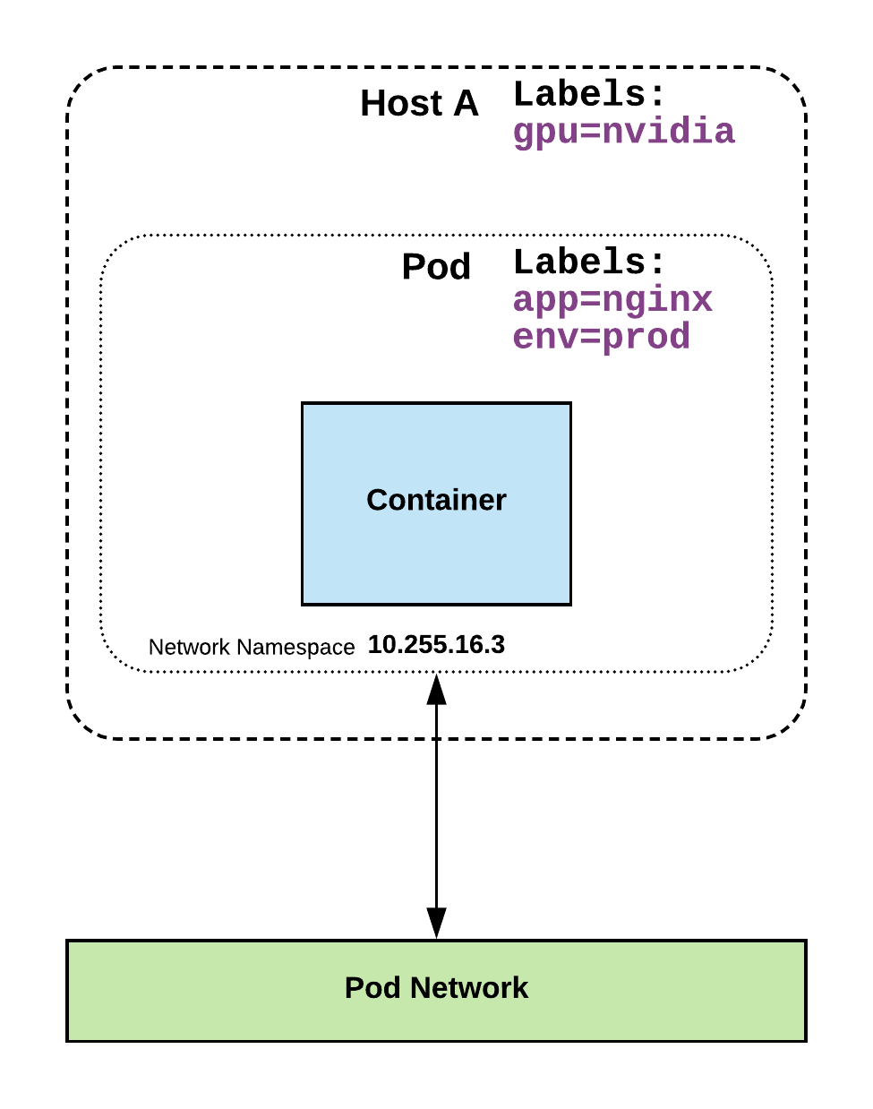
Labels
key-value pairs that are used to identify, describe and group together related sets of objects or resources.
NOT characteristic of uniqueness.
Have a strict syntax with a slightly limited character set*.
* https://kubernetes.io/docs/concepts/overview/working-with-objects/labels/#syntax-and-character-set

Slide 75
Label Example
apiVersion: v1
kind: Pod
metadata:
name: pod-label-example
labels: app: nginx env: prod
spec:
containers:
- name: nginx
image: nginx:stable-alpine
ports:
- containerPort: 80

Slide 76
Selectors
Selectors use labels to filter or select objects, and are used throughout Kubernetes.
apiVersion: v1
kind: Pod
metadata:
name: pod-label-example
labels: app: nginx env: prod
spec:
containers:
- name: nginx
image: nginx:stable-alpine
ports:
- containerPort: 80 nodeSelector:
gpu: nvidia
Notes:
Selectors allow you to create rules based on your labels
NO ‘hard links’ to things, everything is done through labels and selectors

Slide 77
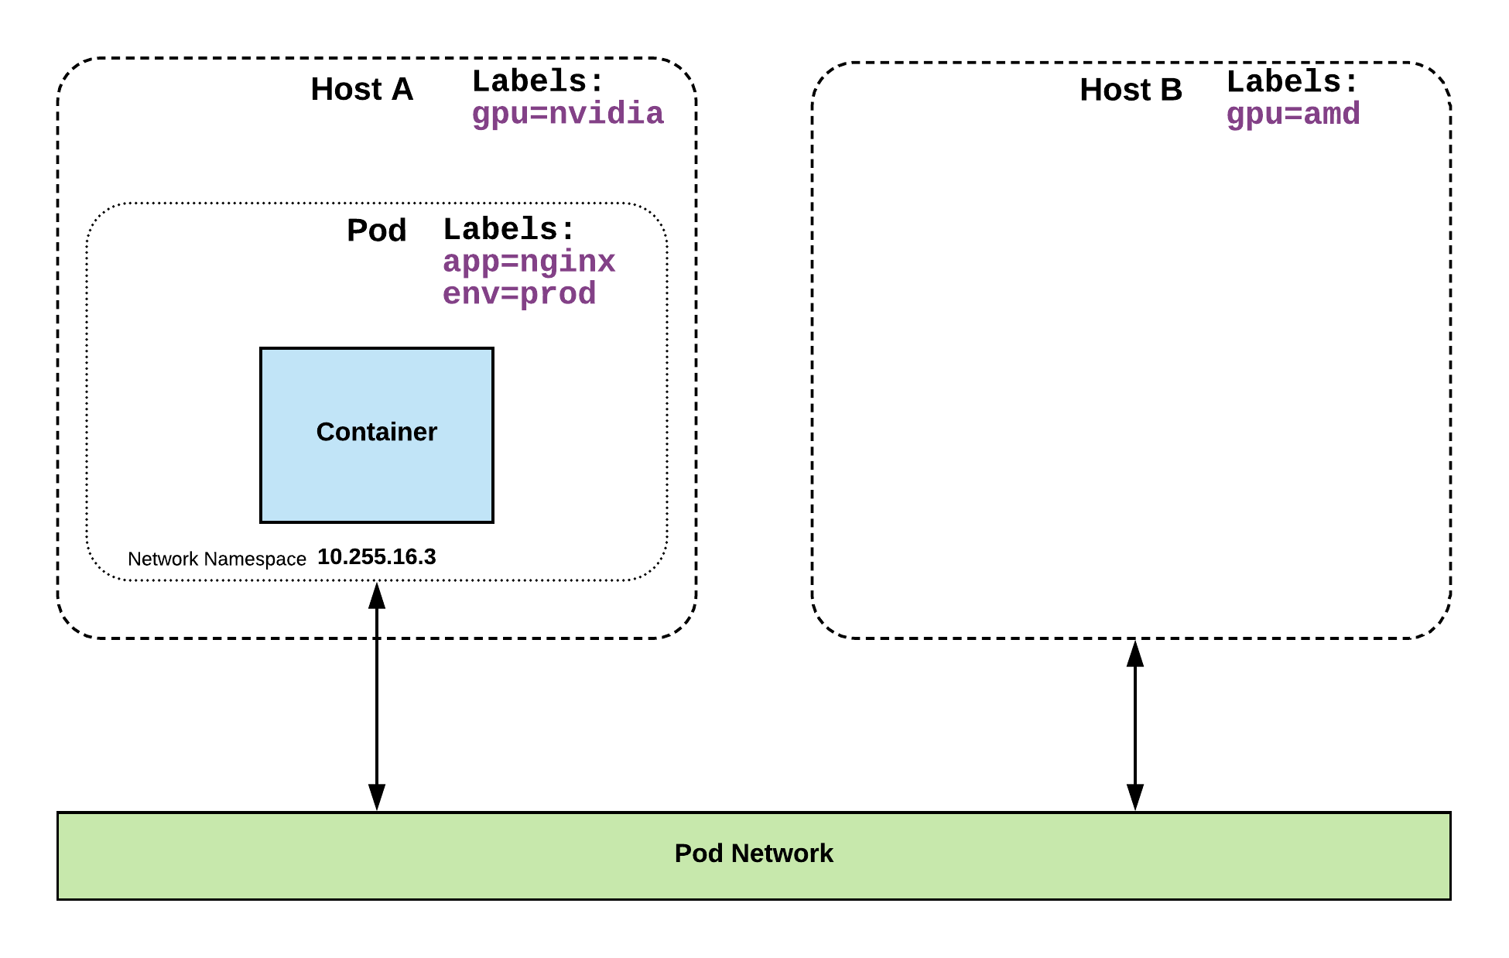
Selector Example
apiVersion: v1
kind: Pod
metadata:
name: pod-label-example
labels: app: nginx env: prod
spec:
containers:
- name: nginx
image: nginx:stable-alpine
ports:
- containerPort: 80 nodeSelector:
gpu: nvidia

Slide 78
Selector Types
Equality based selectors allow for simple filtering (=,==, or !=).
Set-based selectors are supported on a limited subset of objects. However, they provide a method of filtering on a set of values, and supports multiple operators including: in, notin, and exist.
selector:
matchLabels:
gpu: nvidia
selector:
matchExpressions:
- key: gpu
operator: in
values: [“nvidia”]

Slide 79
Services
Unified method of accessing the exposed workloads of Pods.
Durable resource (unlike Pods)
static cluster-unique IP
static namespaced DNS name
<service name>.<namespace>.svc.cluster.local
Notes:
Not ephemeral. Repeat repeat repeat.

Slide 80
Services
Target Pods using equality based selectors.
Uses kube-proxy to provide simple load-balancing.
kube-proxy acts as a daemon that creates local entries in the host’s iptables for every service.
Notes:
This in-turn acts as a simple round-robin load balancer among the Pods targeted by the selector.
More options coming

Slide 81
Service Types
There are 4 major service types:
ClusterIP (default)
NodePort
LoadBalancer
ExternalName
Notes:
clusterIP,LB - Bob
Nodeport,External - Jeff

Slide 82
ClusterIP Service
ClusterIP services exposes a service on a strictly cluster internal virtual IP.
apiVersion: v1
kind: Service
metadata:
name: example-prod
spec:
selector:
app: nginx
env: prod
ports:
- protocol: TCP
port: 80
targetPort: 80
Notes:
ClusterIP is an internal LB for your application

Slide 83
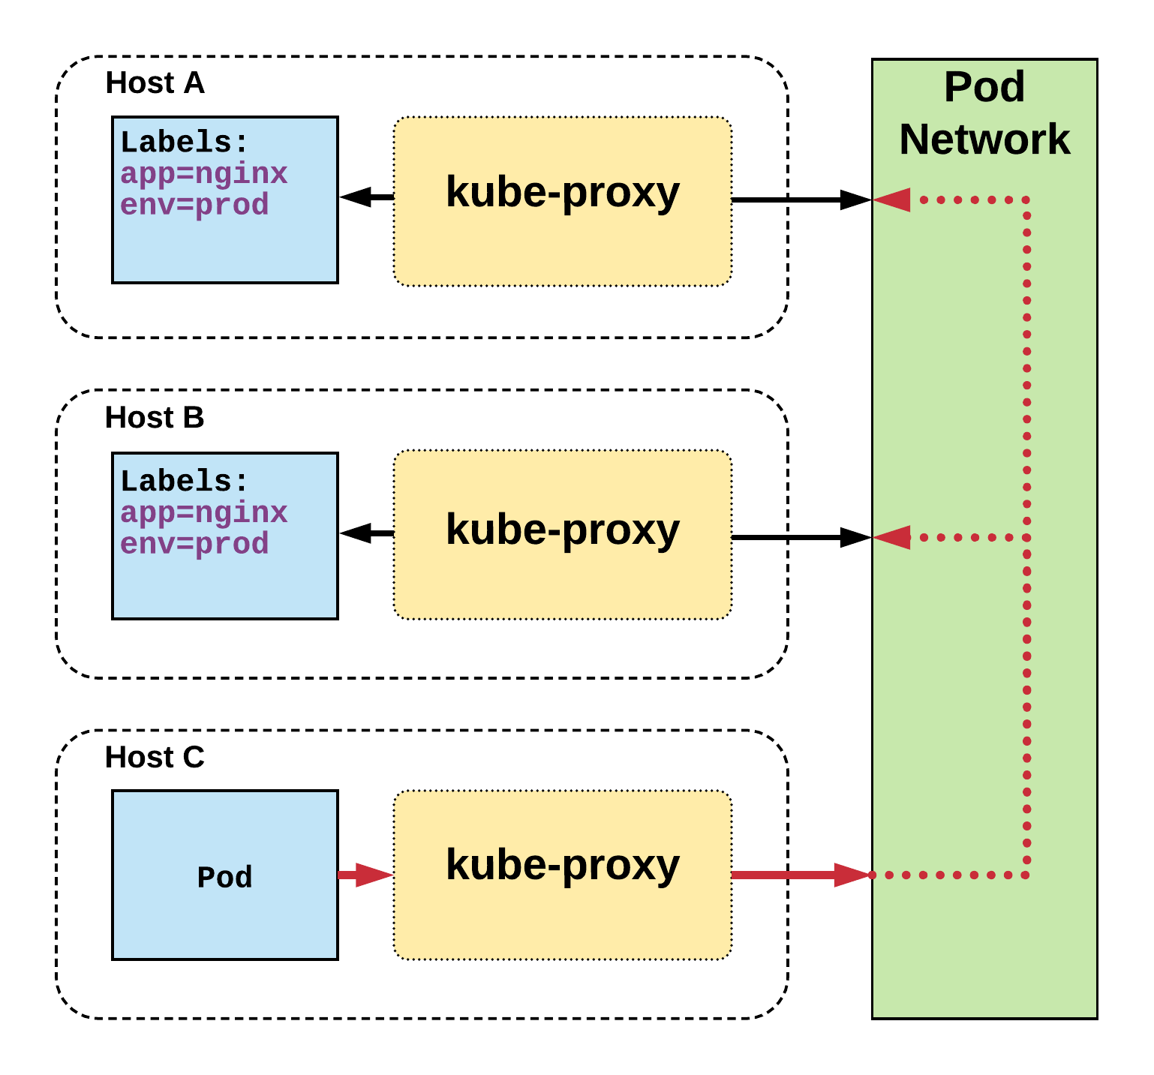
Cluster IP Service
Name: example-prod
Selector: app=nginx,env=prod
Type: ClusterIP
IP: 10.96.28.176
Port: <unset> 80/TCP
TargetPort: 80/TCP
Endpoints: 10.255.16.3:80, 10.255.16.4:80
/ # nslookup example-prod.default.svc.cluster.local
Name: example-prod.default.svc.cluster.local
Address 1: 10.96.28.176 example-prod.default.svc.cluster.local
The Pod on host C requests the service
Hits host iptables and it load-balances the connection between the endpoints residing on Hosts A, B
Notes:
The Pod on host C requests the service
Hits host iptables and it load-balances the connection between the endpoints residing on Hosts A, B

Slide 84
NodePort Service
NodePort services extend the ClusterIP service.
Exposes a port on every node’s IP.
Port can either be statically defined, or dynamically taken from a range between 30000-32767.
apiVersion: v1
kind: Service
metadata:
name: example-prod
spec:
type: NodePort
selector:
app: nginx
env: prod
ports:
- nodePort: 32410
protocol: TCP
port: 80
targetPort: 80
Notes:
NodePort behaves just like ClusterIP, except it also exposes the service on a (random or specified) port on every Node in your cluster.

Slide 85
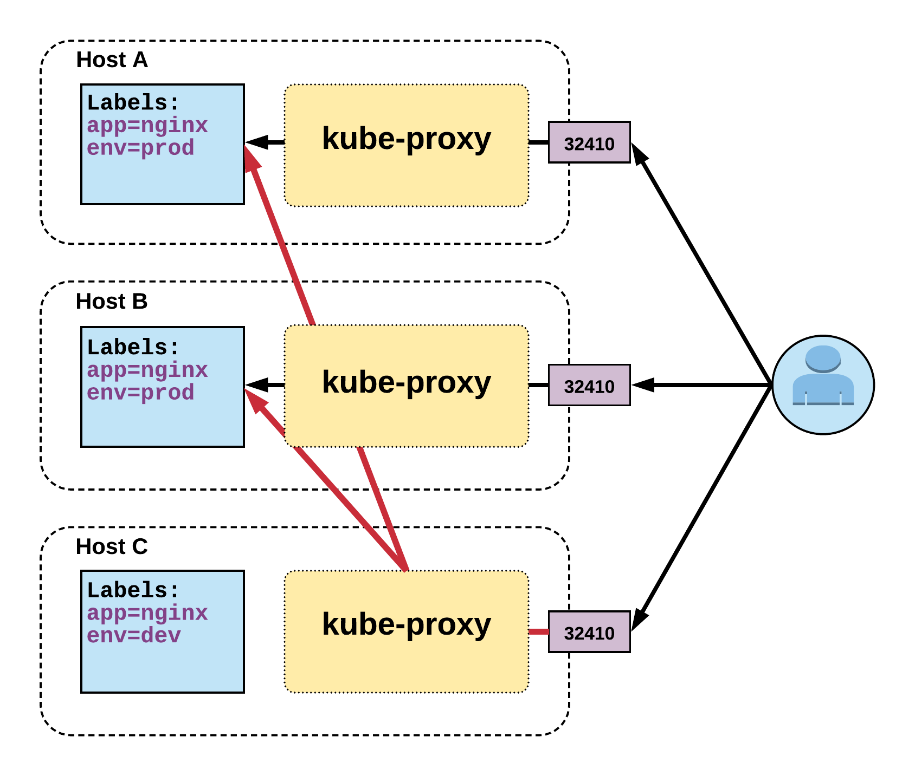
NodePort Service
Name: example-prod
Selector: app=nginx,env=prod
Type: NodePort
IP: 10.96.28.176
Port: <unset> 80/TCP
TargetPort: 80/TCP
NodePort: <unset> 32410/TCP
Endpoints: 10.255.16.3:80, 10.255.16.4:80
User can hit any host in cluster on nodeport IP and get to service
Introduces extra hop if hitting a host without instance of the pod
Notes:
User can hit any host in cluster on nodeport IP and get to service
Does introduce extra hop if hitting a host without instance of the pod

Slide 86
LoadBalancer Service
LoadBalancer services extend NodePort.
Works in conjunction with an external system to map a cluster external IP to the exposed service.
apiVersion: v1
kind: Service
metadata:
name: example-prod
spec:
type: LoadBalancer
selector:
app: nginx
env: prod
ports:
protocol: TCP
port: 80
targetPort: 80
Notes:
Continue to get abstracted and built on top of one another.
The LoadBalancer service extends NodePort turns it into a highly-available externally consumable resource.
-Must- Work with some external system to provide cluster ingress

Slide 87
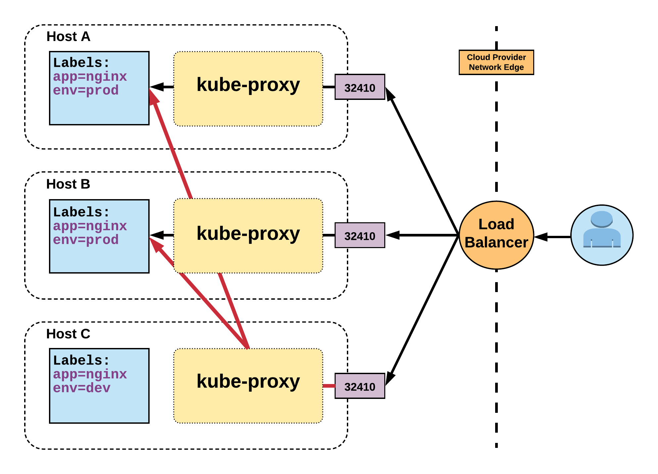
LoadBalancer Service
Name: example-prod
Selector: app=nginx,env=prod
Type: LoadBalancer
IP: 10.96.28.176
LoadBalancer Ingress: 172.17.18.43
Port: <unset> 80/TCP
TargetPort: 80/TCP
NodePort: <unset> 32410/TCP
Endpoints: 10.255.16.3:80, 10.255.16.4:80
Notes:
Gets external IP from provider
There are settings to remove nodes that are not running an instance of the pod. To remove extra hop.

Slide 88
ExternalName Service
ExternalName is used to reference endpoints OUTSIDE the cluster.
Creates an internal CNAME DNS entry that aliases another.
apiVersion: v1
kind: Service
metadata:
name: example-prod
spec:
type: ExternalName
spec:
externalName: example.com
Notes:
Allows you to point your configs and such to a static entry internally that you can update out of band later

Slide 89
Exploring
the Core
Lab - github.com/mrbobbytables/k8s-intro-tutorials/blob/master/core

Slide 90

Exploring
the Core
Lab - github.com/mrbobbytables/k8s-intro-tutorials/blob/master/core

Slide 91
ReplicaSet
Deployment
DaemonSet
StatefulSet
Job
CronJob
Workloads
Concepts and Resources
Notes:
rs,ds,j/cronjob - jeff
dep,sts - bob

Slide 92
Using Workloads
Lab - github.com/mrbobbytables/k8s-intro-tutorials/blob/master/workloads

Slide 93
Workloads
Workloads within Kubernetes are higher level objects that manage Pods or other higher level objects.
In ALL CASES a Pod Template is included, and acts the base tier of management.
Notes:
Workloads take the fundamentals we’ve talked about and transform them into something meaningful.
But everything revolves around (at a minimum) a Pod Template.
And some even template other higher level objects.

Slide 94
Pod Template
Workload Controllers manage instances of Pods based off a provided template.
Pod Templates are Pod specs with limited metadata.
Controllers use Pod Templates to make actual pods.
apiVersion: v1
kind: Pod
metadata:
name: pod-example
labels: app: nginx
spec:
containers:
- name: nginx
image: nginx
template:
metadata:
labels: app: nginx
spec:
containers:
- name: nginx
image: nginx
Notes:
Essentially a Pod without a name
No need to supply apiVersion or Kind

Slide 95
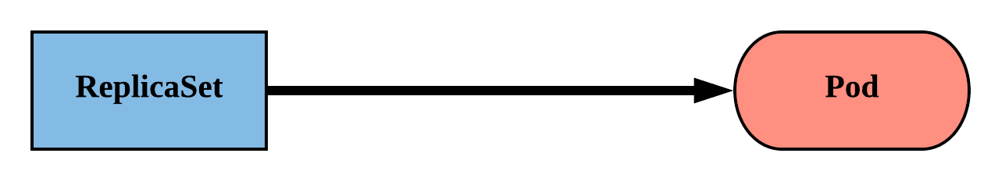
ReplicaSet
Primary method of managing pod replicas and their lifecycle.
Includes their scheduling, scaling, and deletion.
Their job is simple: Always ensure the desired number of pods are running.
Notes:
ReplicaSets are “dumb”
They strive to ensure the number of pods you want running will stay running

Slide 96
ReplicaSet
replicas: The desired number of instances of the Pod.
selector:The label selector for the ReplicaSet will manage ALL Pod instances that it targets; whether it’s desired or not.
apiVersion: apps/v1
kind: ReplicaSet
metadata:
name: rs-example
spec:
replicas: 3
selector:
matchLabels:
app: nginx env: prod
template:
<pod template>
Notes:
You define the number of pods you want running with the replicas field.
You then define the selector the ReplicaSet will use to look for Pods and ensure they’re running.

Slide 97
ReplicaSet
apiVersion: apps/v1
kind: ReplicaSet
metadata:
name: rs-example
spec:
replicas: 3
selector:
matchLabels:
app: nginx env: prod
template:
metadata:
labels:
app: nginx
env: prod
spec:
containers:
- name: nginx
image: nginx:stable-alpine
ports:
- containerPort: 80
$ kubectl get pods
NAME READY STATUS RESTARTS AGE
rs-example-9l4dt 1/1 Running 0 1h
rs-example-b7bcg 1/1 Running 0 1h
rs-example-mkll2 1/1 Running 0 1h
$ kubectl describe rs rs-example
Name: rs-example
Namespace: default
Selector: app=nginx,env=prod
Labels: app=nginx
env=prod
Annotations: <none>
Replicas: 3 current / 3 desired
Pods Status: 3 Running / 0 Waiting / 0 Succeeded / 0 Failed
Pod Template:
Labels: app=nginx
env=prod
Containers:
nginx:
Image: nginx:stable-alpine
Port: 80/TCP
Environment: <none>
Mounts: <none>
Volumes: <none>
Events:
Type Reason Age From Message
---- ------ ---- ---- -------
Normal SuccessfulCreate 16s replicaset-controller Created pod: rs-example-mkll2
Normal SuccessfulCreate 16s replicaset-controller Created pod: rs-example-b7bcg
Normal SuccessfulCreate 16s replicaset-controller Created pod: rs-example-9l4dt
Notes:
Selector and labels within the pod template match
This may seem redundant, but there are edge-case instances where you might not always want them to match. A little redundancy here also grants us a very flexible and powerful tool.
Pods have generated name based off replicaset name + random 5 character string

Slide 98
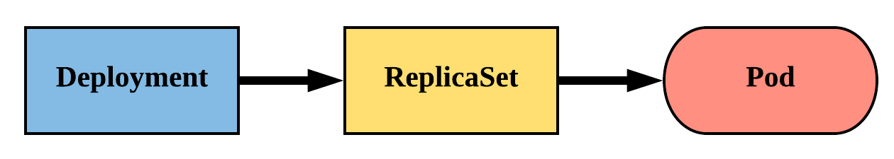
Deployment
Declarative method of managing Pods via ReplicaSets.
Provide rollback functionality and update control.
Updates are managed through the pod-template-hash label.
Each iteration creates a unique label that is assigned to both the ReplicaSet and subsequent Pods.
Notes:
The real way we manage pods
Deployments manage replicasets which then manage pods
Rare that you manage replicasets directly because they are ‘dumb’
Offer update control and rollback functionality, gives blue/green deployment
Does this through hashing the pod template and storing that value in a label, the pod template hash
Used in replicaset name
Added to the selector and pod labels automatically
gives us a unique selector that strictly targets a revision of a pod

Slide 99
Deployment
revisionHistoryLimit: The number of previous iterations of the Deployment to retain.
strategy: Describes the method of updating the Pods based on the type. Valid options are Recreate or RollingUpdate.
Recreate: All existing Pods are killed before the new ones are created.
RollingUpdate: Cycles through updating the Pods according to the parameters: maxSurge and maxUnavailable.
apiVersion: apps/v1
kind: Deployment
metadata:
name: deploy-example
spec:
replicas: 3 revisionHistoryLimit: 3
selector:
matchLabels:
app: nginx env: prod
strategy:
type: RollingUpdate
rollingUpdate:
maxSurge: 1
maxUnavailable: 0
template:
<pod template>
Notes:
Since we now have rollback functionality, we now have to know how many previous versions we want to keep
strategy describes the method used to update the deployment
recreate is pretty self explanatory, nuke it and recreate, not graceful
rolling update is what we normally want
max Sure == how many ADDITIONAL replicas we want to spin up while updating
max Unavailable == how many may be unavailable during the update process
Lets say you’re resource constrained and can only support 3 replicas of the pod at any one time We could set maxSurge to 0 and maxUnavailable to 1. This would cycle through updating 1 at a time without spinning up additional pods.

Slide 100
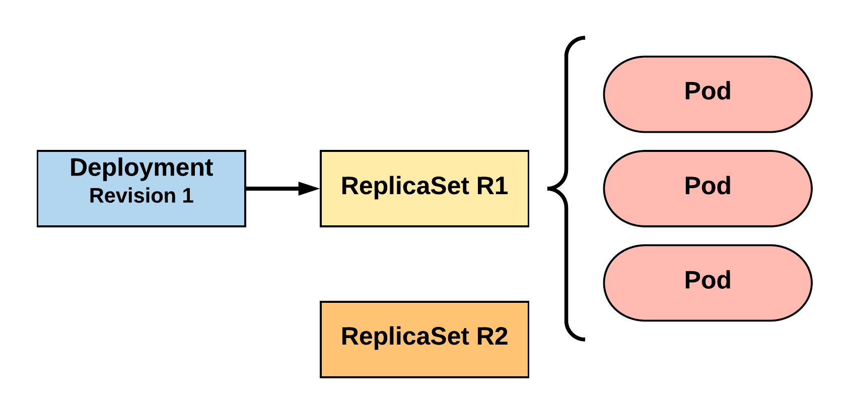
RollingUpdate Deployment
Updating pod template generates a new ReplicaSet revision.
R1 pod-template-hash: 676677fff
R2 pod-template-hash: 54f7ff7d6d
$ kubectl get replicaset
NAME DESIRED CURRENT READY AGE
mydep-6766777fff 3 3 3 5h
$ kubectl get pods
NAME READY STATUS RESTARTS AGE
mydep-6766777fff-9r2zn 1/1 Running 0 5h
mydep-6766777fff-hsfz9 1/1 Running 0 5h
mydep-6766777fff-sjxhf 1/1 Running 0 5h
Notes:
We add a new label, change the image, do something to change the pod template in some way
The deployment controller creates a new replicaset with 0 instances to start

Slide 101
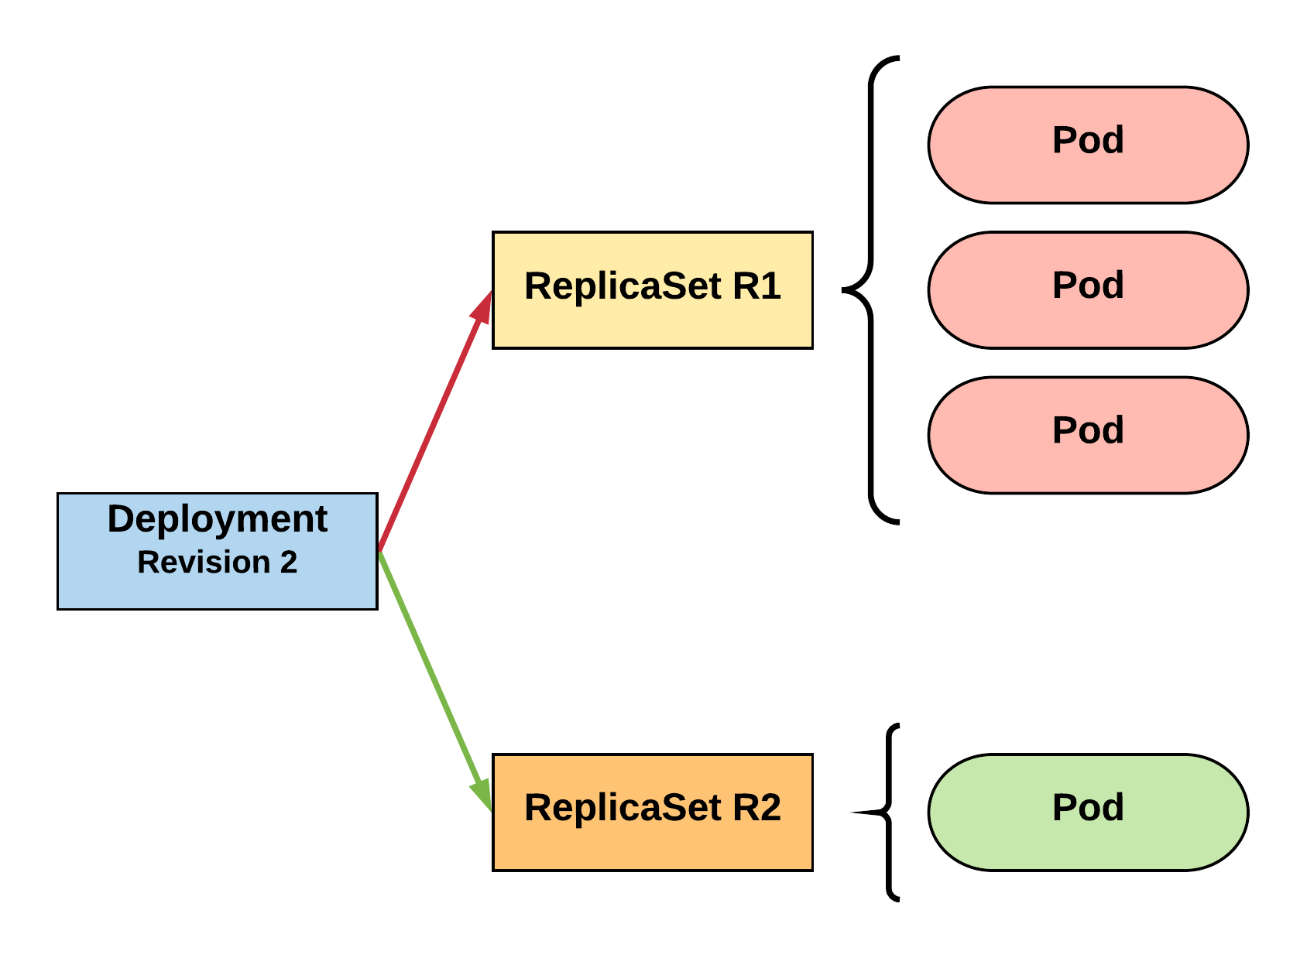
RollingUpdate Deployment
New ReplicaSet is initially scaled up based on maxSurge.
R1 pod-template-hash: 676677fff
R2 pod-template-hash: 54f7ff7d6d
$ kubectl get replicaset
NAME DESIRED CURRENT READY AGE mydep-54f7ff7d6d 1 1 1 5s
mydep-6766777fff 2 3 3 5h
$ kubectl get pods
NAME READY STATUS RESTARTS AGE
mydep-54f7ff7d6d-9gvll 1/1 Running 0 2s
mydep-6766777fff-9r2zn 1/1 Running 0 5h
mydep-6766777fff-hsfz9 1/1 Running 0 5h
mydep-6766777fff-sjxhf 1/1 Running 0 5h
Notes:
It then scales up the new ReplicaSet based on our maxSurge value

Slide 102
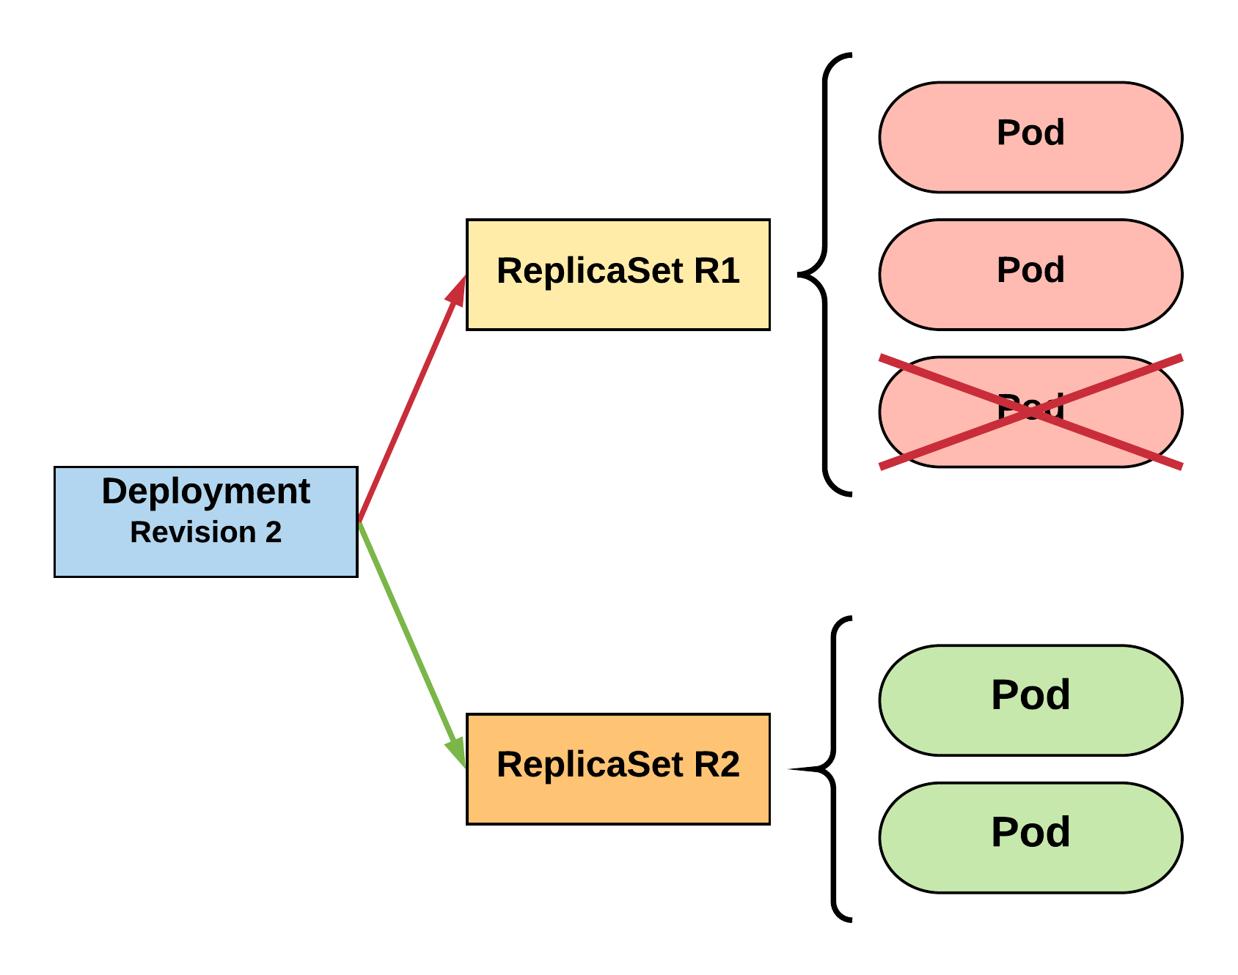
RollingUpdate Deployment
Phase out of old Pods managed by maxSurge and maxUnavailable.
R1 pod-template-hash: 676677fff
R2 pod-template-hash: 54f7ff7d6d
$ kubectl get replicaset
NAME DESIRED CURRENT READY AGE mydep-54f7ff7d6d 2 2 2 8s
mydep-6766777fff 2 2 2 5h
$ kubectl get pods
NAME READY STATUS RESTARTS AGE
mydep-54f7ff7d6d-9gvll 1/1 Running 0 5s
mydep-54f7ff7d6d-cqvlq 1/1 Running 0 2s
mydep-6766777fff-9r2zn 1/1 Running 0 5h
mydep-6766777fff-hsfz9 1/1 Running 0 5h
Notes:
It will then begin to kill off the prevision revision by scaling down the old replicaset and scaling up the new one

Slide 103
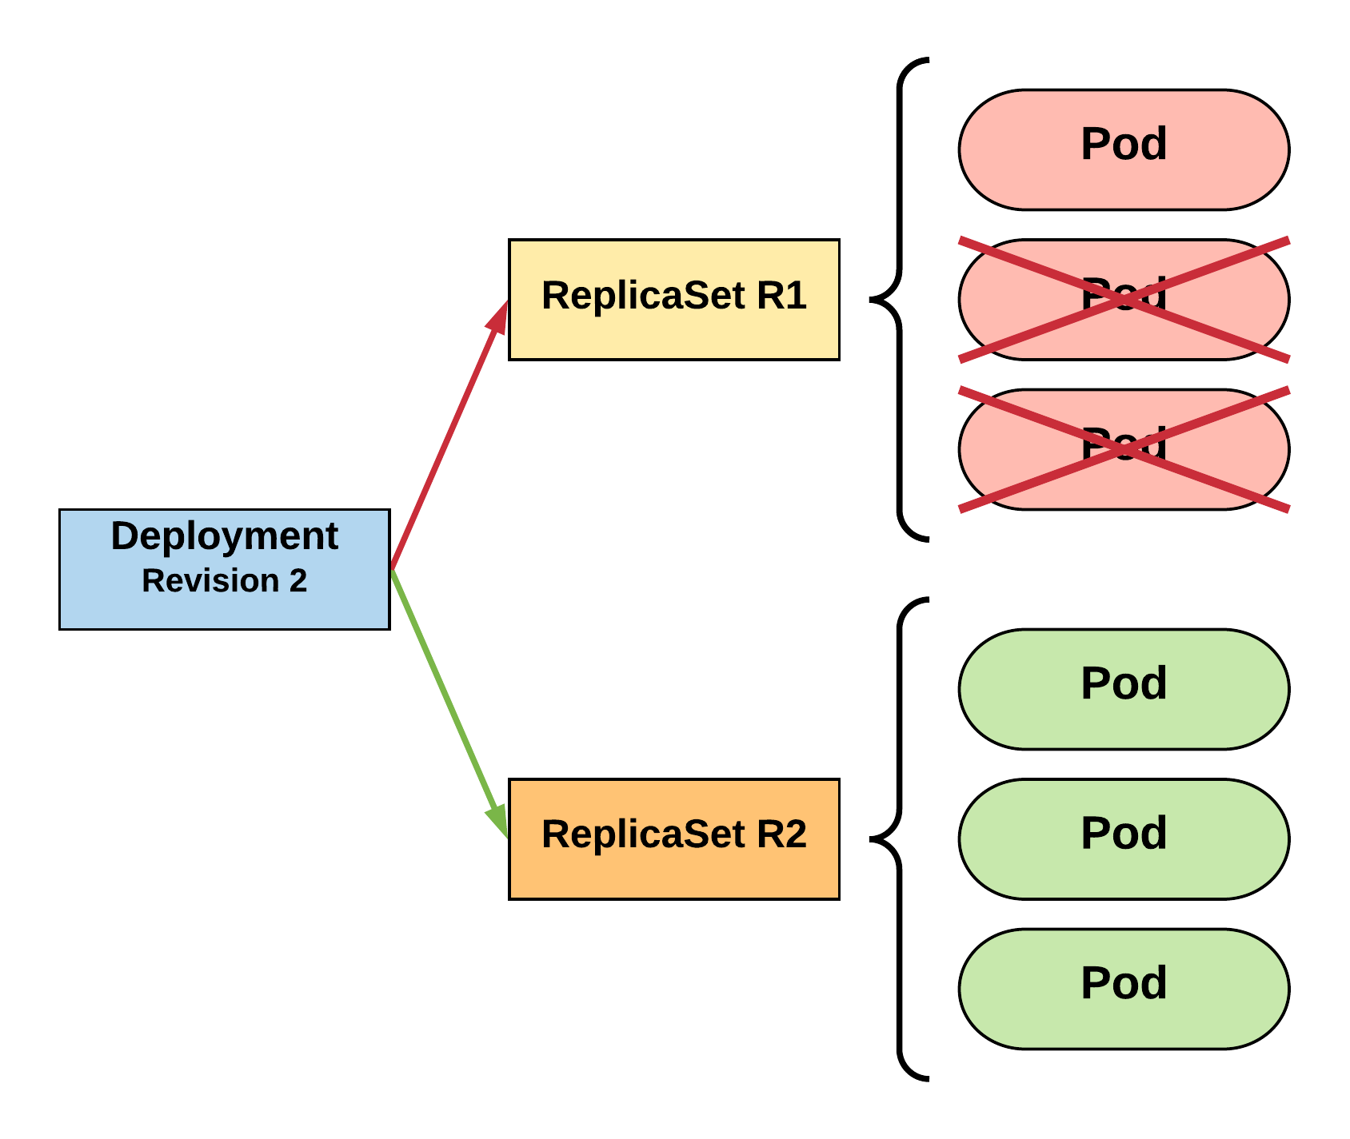
RollingUpdate Deployment
Phase out of old Pods managed by maxSurge and maxUnavailable.
R1 pod-template-hash: 676677fff
R2 pod-template-hash: 54f7ff7d6d
$ kubectl get replicaset
NAME DESIRED CURRENT READY AGE mydep-54f7ff7d6d 3 3 3 10s
mydep-6766777fff 0 1 1 5h
$ kubectl get pods
NAME READY STATUS RESTARTS AGE
mydep-54f7ff7d6d-9gvll 1/1 Running 0 7s
mydep-54f7ff7d6d-cqvlq 1/1 Running 0 5s
mydep-54f7ff7d6d-gccr6 1/1 Running 0 2s
mydep-6766777fff-9r2zn 1/1 Running 0 5h
Notes:
Continues this pattern based on maxSurge and maxUnavailable

Slide 104
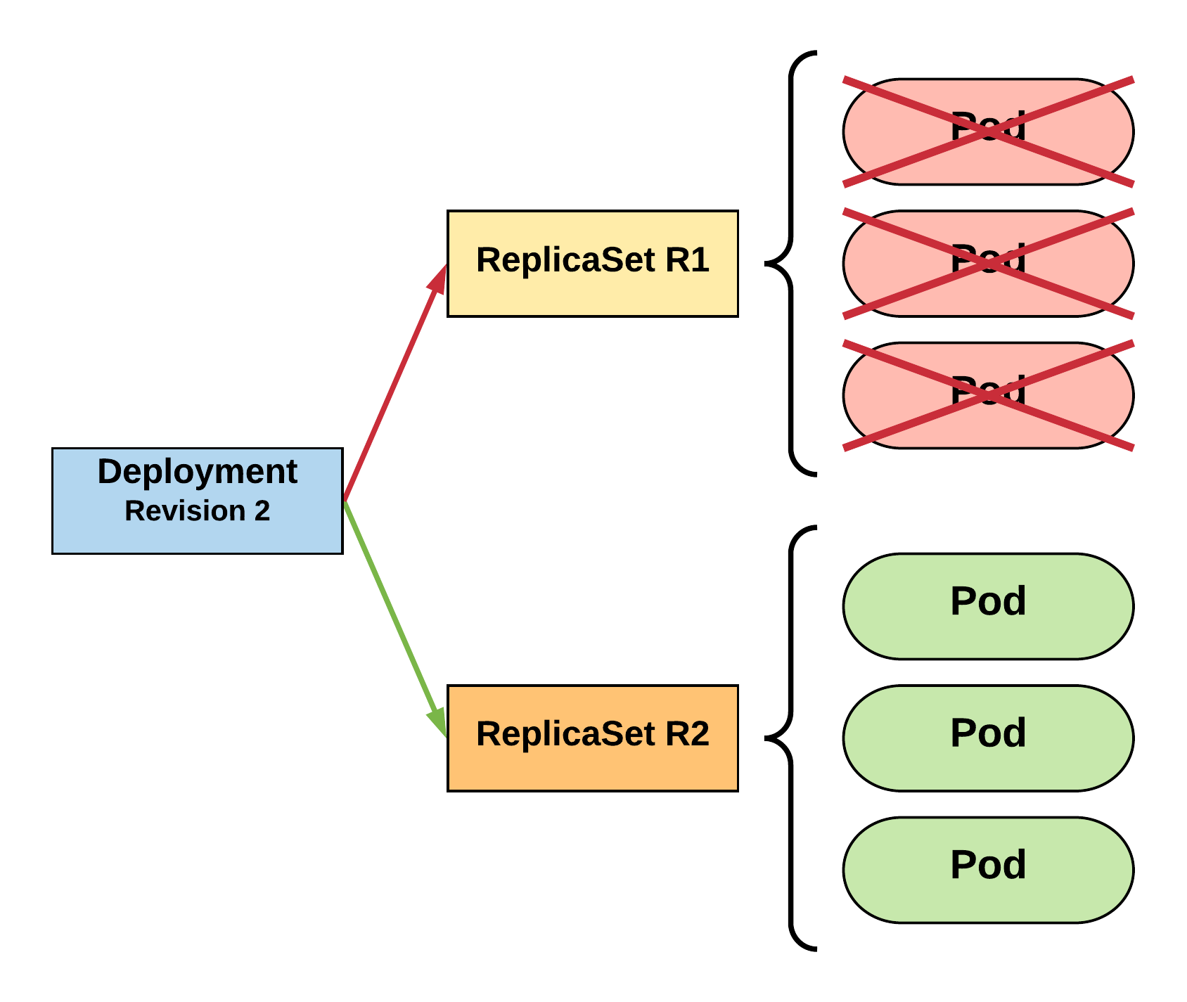
RollingUpdate Deployment
Phase out of old Pods managed by maxSurge and maxUnavailable.
R1 pod-template-hash: 676677fff
R2 pod-template-hash: 54f7ff7d6d
$ kubectl get replicaset
NAME DESIRED CURRENT READY AGE
mydep-54f7ff7d6d 3 3 3 13s mydep-6766777fff 0 0 0 5h
$ kubectl get pods
NAME READY STATUS RESTARTS AGE
mydep-54f7ff7d6d-9gvll 1/1 Running 0 10s
mydep-54f7ff7d6d-cqvlq 1/1 Running 0 8s
mydep-54f7ff7d6d-gccr6 1/1 Running 0 5s
Notes:
Update is complete

Slide 105
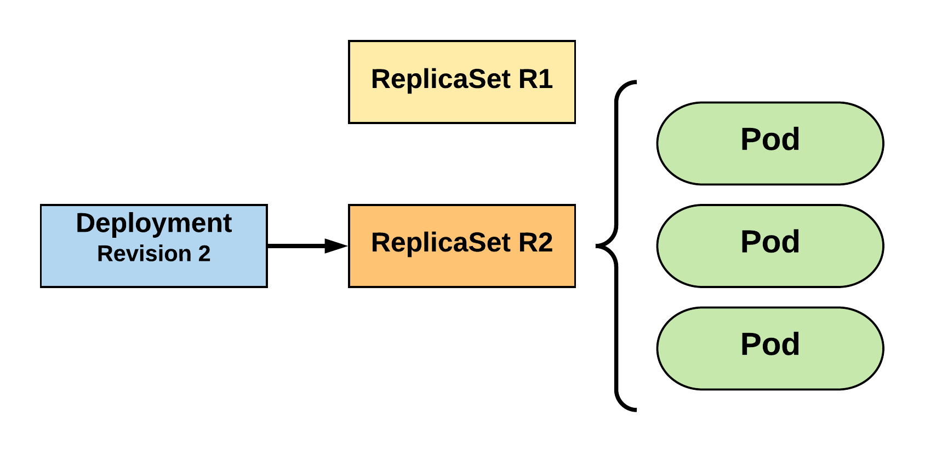
RollingUpdate Deployment
Updated to new deployment revision completed.
R1 pod-template-hash: 676677fff
R2 pod-template-hash: 54f7ff7d6d
$ kubectl get replicaset
NAME DESIRED CURRENT READY AGE mydep-54f7ff7d6d 3 3 3 15s
mydep-6766777fff 0 0 0 5h
$ kubectl get pods
NAME READY STATUS RESTARTS AGE
mydep-54f7ff7d6d-9gvll 1/1 Running 0 12s
mydep-54f7ff7d6d-cqvlq 1/1 Running 0 10s
mydep-54f7ff7d6d-gccr6 1/1 Running 0 7s
Notes:
Until the previous revision is at 0
ReplicaSet will remain around, but it will have 0 replicas. How many stay around are based off our revision history limit

Slide 106
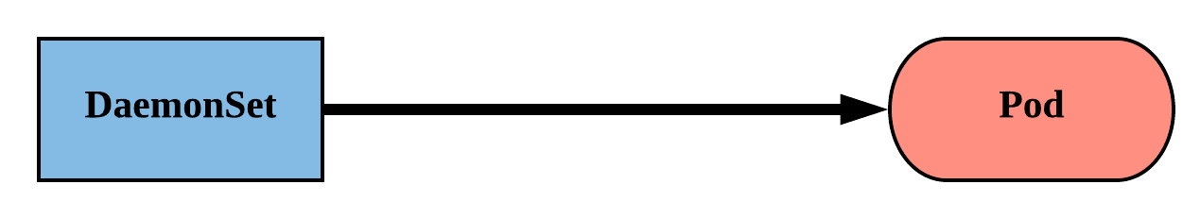
DaemonSet
Ensure that all nodes matching certain criteria will run an instance of the supplied Pod.
They bypass default scheduling mechanisms.
It is ideal for cluster wide services such as log forwarding, or health monitoring.
Revisions are managed via a controller-revision-hash label.
Notes:
Daemonsets schedule pods across all nodes matching certain criteria.
They work best for services like log shipping and health monitoring.
The criteria can be anything from the specific OS or Arch, or your own cluster-specific labels.

Slide 107
DaemonSet
revisionHistoryLimit: The number of previous iterations of the DaemonSet to retain.
updateStrategy: Describes the method of updating the Pods based on the type. Valid options are RollingUpdate or OnDelete.
RollingUpdate: Cycles through updating the Pods according to the value of maxUnavailable.
OnDelete: The new instance of the Pod is deployed ONLY after the current instance is deleted.
apiVersion: apps/v1
kind: DaemonSet
metadata:
name: ds-example
spec:
revisionHistoryLimit: 3
selector:
matchLabels:
app: nginx
updateStrategy:
type: RollingUpdate
rollingUpdate:
maxUnavailable: 1
template:
spec:
nodeSelector:
nodeType: edge
<pod template>
Notes:
Revisions are based around the controller-revision hash.
RollingUpdate in this case doesn’t surge. You can’t scale up nodes in the eyes of a DS. It uses max-unavailable instead.
There is also OnDelete, which requires human intervention to manually delete the instance.

Slide 108
DaemonSet
spec.template.spec.nodeSelector: The primary selector used to target nodes.
Default Host Labels:
kubernetes.io/hostname
beta.kubernetes.io/os
beta.kubernetes.io/arch
Cloud Host Labels:
failure-domain.beta.kubernetes.io/zone
failure-domain.beta.kubernetes.io/region
beta.kubernetes.io/instance-type
apiVersion: apps/v1
kind: DaemonSet
metadata:
name: ds-example
spec:
revisionHistoryLimit: 3
selector:
matchLabels:
app: nginx
updateStrategy:
type: RollingUpdate
rollingUpdate:
maxUnavailable: 1
template:
spec:
nodeSelector:
nodeType: edge
<pod template>
Notes:
Here are a couple examples of commonly-used labels for DSs.

Slide 109
DaemonSet
apiVersion: apps/v1
kind: DaemonSet
metadata:
name: ds-example
spec:
revisionHistoryLimit: 3
selector:
matchLabels:
app: nginx
updateStrategy:
type: RollingUpdate
rollingUpdate:
maxUnavailable: 1
template:
metadata:
labels:
app: nginx
spec:
nodeSelector:
nodeType: edge
containers:
- name: nginx
image: nginx:stable-alpine
ports:
- containerPort: 80
$ kubectl get pods
NAME READY STATUS RESTARTS AGE
ds-example-x8kkz 1/1 Running 0 1m
$ kubectl describe ds ds-example
Name: ds-example
Selector: app=nginx,env=prod
Node-Selector: nodeType=edge
Labels: app=nginx
env=prod
Annotations: <none>
Desired Number of Nodes Scheduled: 1
Current Number of Nodes Scheduled: 1
Number of Nodes Scheduled with Up-to-date Pods: 1
Number of Nodes Scheduled with Available Pods: 1
Number of Nodes Misscheduled: 0
Pods Status: 1 Running / 0 Waiting / 0 Succeeded / 0 Failed
Pod Template:
Labels: app=nginx
env=prod
Containers:
nginx:
Image: nginx:stable-alpine
Port: 80/TCP
Environment: <none>
Mounts: <none>
Volumes: <none>
Events:
Type Reason Age From Message
---- ------ ---- ---- -------
Normal SuccessfulCreate 48s daemonset-controller Created pod: ds-example-x8kkz

Slide 110
DaemonSet
apiVersion: apps/v1
kind: DaemonSet
metadata:
name: ds-example
spec:
revisionHistoryLimit: 3
selector:
matchLabels:
app: nginx
updateStrategy:
type: RollingUpdate
rollingUpdate:
maxUnavailable: 1
template:
metadata:
labels:
app: nginx
spec:
nodeSelector:
nodeType: edge
containers:
- name: nginx
image: nginx:stable-alpine
ports:
- containerPort: 80
$ kubectl get pods
NAME READY STATUS RESTARTS AGE
ds-example-x8kkz 1/1 Running 0 1m
$ kubectl describe ds ds-example
Name: ds-example
Selector: app=nginx,env=prod
Node-Selector: nodeType=edge
Labels: app=nginx
env=prod
Annotations: <none>
Desired Number of Nodes Scheduled: 1
Current Number of Nodes Scheduled: 1
Number of Nodes Scheduled with Up-to-date Pods: 1
Number of Nodes Scheduled with Available Pods: 1
Number of Nodes Misscheduled: 0
Pods Status: 1 Running / 0 Waiting / 0 Succeeded / 0 Failed
Pod Template:
Labels: app=nginx
env=prod
Containers:
nginx:
Image: nginx:stable-alpine
Port: 80/TCP
Environment: <none>
Mounts: <none>
Volumes: <none>
Events:
Type Reason Age From Message
---- ------ ---- ---- -------
Normal SuccessfulCreate 48s daemonset-controller Created pod: ds-example-x8kkz

Slide 111
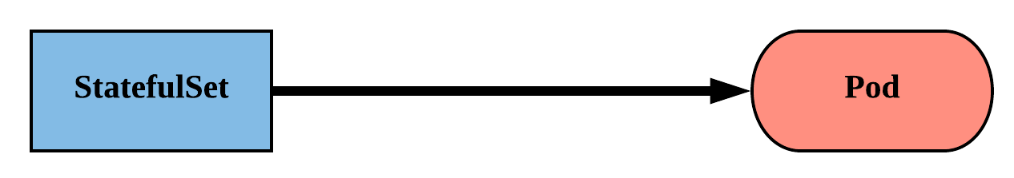
StatefulSet
Tailored to managing Pods that must persist or maintain state.
Pod identity including hostname, network, and storage WILL be persisted.
Assigned a unique ordinal name following the convention of ‘<statefulset name>-<ordinal index>’.
Notes:
Tailored to apps that must persist or maintain state: namely databases
Generally these systems care a bit more about their identity, their hostname their IP etc
instead of that random string on the end of a pod name, they’ll get a predictable value
Follows the convention of statefulset name - ordinal index
ordinal index correlates to replica
Ordinal starts at 0, just like a normal array e.g. mysql-0
naming convention carries over to network identity and storage

Slide 112
StatefulSet
Naming convention is also used in Pod’s network Identity and Volumes.
Pod lifecycle will be ordered and follow consistent patterns.
Revisions are managed via a controller-revision-hash label
Notes:
Each pod is given a unique network identity and if desired matching storage
fundamentally different from how we’ve thought of pods and services so far
Lifecycle of these statefulsets follow a predictable pattern as well
mysql-0 is always started first before mysql-1
deleting and updating is also done in reverse order, mysql-1 is deleted before mysql-0
pattern is useful when a ‘master’ or ‘leader’ is elected (usually 0) will be the first up and the last one updated

Slide 113
StatefulSet
apiVersion: apps/v1
kind: StatefulSet
metadata:
name: sts-example
spec:
replicas: 2
revisionHistoryLimit: 3
selector:
matchLabels:
app: stateful
serviceName: app
updateStrategy:
type: RollingUpdate
rollingUpdate:
partition: 0
template:
metadata:
labels:
app: stateful
<continued>
<continued>
spec:
containers:
- name: nginx
image: nginx:stable-alpine
ports:
- containerPort: 80
volumeMounts:
- name: www
mountPath: /usr/share/nginx/html
volumeClaimTemplates:
- metadata:
name: www
spec:
accessModes: [ "ReadWriteOnce" ]
storageClassName: standard
resources:
requests:
storage: 1Gi
Notes:
Had to span 2 ‘pages’ as its rather big
Don’t worry, will go over this stuff in more detail
If you want to look at this more closely, goto: workloads/manifests/sts-example.yaml

Slide 114
StatefulSet
revisionHistoryLimit: The number of previous iterations of the StatefulSet to retain.
serviceName: The name of the associated headless service; or a service without a ClusterIP.
apiVersion: apps/v1
kind: StatefulSet
metadata:
name: sts-example
spec:
replicas: 2
revisionHistoryLimit: 3
selector:
matchLabels:
app: stateful
serviceName: app
updateStrategy:
type: RollingUpdate
rollingUpdate:
partition: 0
template:
<pod template>
Notes:
Just like Deployments and Daemonsets, it can keep track of revisions
be careful rolling back as some applications will change file/structure schema and it may cause more problems
serviceName is first unique aspect of statefulsets
maps to the name of a service you create along with the StatefulSet that helps provide pod network identity
Headless service, or a service without a ClusterIP. No NAT’ing, No load balancing.
It will contain a list of the pod endpoints and provides a mechanism for unique DNS names

Slide 115
Headless Service
<StatefulSet Name>-<ordinal>.<service name>.<namespace>.svc.cluster.local
apiVersion: v1
kind: Service
metadata:
name: app
spec:
clusterIP: None
selector:
app: stateful
ports:
- protocol: TCP
port: 80
targetPort: 80
/ # dig app.default.svc.cluster.local +noall +answer
; <<>> DiG 9.11.2-P1 <<>> app.default.svc.cluster.local +noall +answer
;; global options: +cmd
app.default.svc.cluster.local. 2 IN A 10.255.0.5
app.default.svc.cluster.local. 2 IN A 10.255.0.2
/ # dig sts-example-0.app.default.svc.cluster.local +noall +answer
; <<>> DiG 9.11.2-P1 <<>> sts-example-0.app.default.svc.cluster.local +noall +answer
;; global options: +cmd
sts-example-0.app.default.svc.cluster.local. 20 IN A 10.255.0.2
/ # dig sts-example-1.app.default.svc.cluster.local +noall +answer
; <<>> DiG 9.11.2-P1 <<>> sts-example-1.app.default.svc.cluster.local +noall +answer
;; global options: +cmd
sts-example-1.app.default.svc.cluster.local. 30 IN A 10.255.0.5
$ kubectl get pods
NAME READY STATUS RESTARTS AGE
sts-example-0 1/1 Running 0 11m
sts-example-1 1/1 Running 0 11m
Notes:
Follows pattern of <StatefulSet Name>-<ordinal>.<service name>.<namespace>.svc.cluster.local
Note: clusterIP is set to None

Slide 116
Headless Service
<StatefulSet Name>-<ordinal>.<service name>.<namespace>.svc.cluster.local
apiVersion: v1
kind: Service
metadata:
name: app
spec:
clusterIP: None
selector:
app: stateful
ports:
- protocol: TCP
port: 80
targetPort: 80
/ # dig app.default.svc.cluster.local +noall +answer
; <<>> DiG 9.11.2-P1 <<>> app.default.svc.cluster.local +noall +answer
;; global options: +cmd
app.default.svc.cluster.local. 2 IN A 10.255.0.5
app.default.svc.cluster.local. 2 IN A 10.255.0.2
/ # dig sts-example-0.app.default.svc.cluster.local +noall +answer
; <<>> DiG 9.11.2-P1 <<>> sts-example-0.app.default.svc.cluster.local +noall +answer
;; global options: +cmd
sts-example-0.app.default.svc.cluster.local. 20 IN A 10.255.0.2
/ # dig sts-example-1.app.default.svc.cluster.local +noall +answer
; <<>> DiG 9.11.2-P1 <<>> sts-example-1.app.default.svc.cluster.local +noall +answer
;; global options: +cmd
sts-example-1.app.default.svc.cluster.local. 30 IN A 10.255.0.5
$ kubectl get pods
NAME READY STATUS RESTARTS AGE
sts-example-0 1/1 Running 0 11m
sts-example-1 1/1 Running 0 11m
Notes:
Can query the service name directly it will return multiple records containing all our pods

Slide 117
Headless Service
<StatefulSet Name>-<ordinal>.<service name>.<namespace>.svc.cluster.local
apiVersion: v1
kind: Service
metadata:
name: app
spec:
clusterIP: None
selector:
app: stateful
ports:
- protocol: TCP
port: 80
targetPort: 80
/ # dig app.default.svc.cluster.local +noall +answer
; <<>> DiG 9.11.2-P1 <<>> app.default.svc.cluster.local +noall +answer
;; global options: +cmd
app.default.svc.cluster.local. 2 IN A 10.255.0.5
app.default.svc.cluster.local. 2 IN A 10.255.0.2
/ # dig sts-example-0.app.default.svc.cluster.local +noall +answer
; <<>> DiG 9.11.2-P1 <<>> sts-example-0.app.default.svc.cluster.local +noall +answer
;; global options: +cmd
sts-example-0.app.default.svc.cluster.local. 20 IN A 10.255.0.2
/ # dig sts-example-1.app.default.svc.cluster.local +noall +answer
; <<>> DiG 9.11.2-P1 <<>> sts-example-1.app.default.svc.cluster.local +noall +answer
;; global options: +cmd
sts-example-1.app.default.svc.cluster.local. 30 IN A 10.255.0.5
$ kubectl get pods
NAME READY STATUS RESTARTS AGE
sts-example-0 1/1 Running 0 11m
sts-example-1 1/1 Running 0 11m
Notes:
or can query for pod directly

Slide 118
StatefulSet
updateStrategy: Describes the method of updating the Pods based on the type. Valid options are OnDelete or RollingUpdate.
OnDelete: The new instance of the Pod is deployed ONLY after the current instance is deleted.
RollingUpdate: Pods with an ordinal greater than the partition value will be updated in one-by-one in reverse order.
apiVersion: apps/v1
kind: StatefulSet
metadata:
name: sts-example
spec:
replicas: 2
revisionHistoryLimit: 3
selector:
matchLabels:
app: stateful
serviceName: app
updateStrategy:
type: RollingUpdate
rollingUpdate:
partition: 0
template:
<pod template>
Notes:
OnDelete behaves just as it did with DaemonSets. The instance won’t update till it is deleted.
RollingUpdate functions a little bit differently with statefulsets
updates are done in reverse order based on ordinal, and are done one-by-one
5 replicas, mysql-4, then mysql-3, then 2,1,0
can be controlled by partition attribute which lets you manually gate how many instances update
instances with an ordinal greater than or equal to will be updated

Slide 119
StatefulSet
volumeClaimTemplates: Template of the persistent volume(s) request to use for each instance of the StatefulSet.
spec:
containers:
- name: nginx
image: nginx:stable-alpine
ports:
- containerPort: 80
volumeMounts:
- name: www
mountPath: /usr/share/nginx/html
volumeClaimTemplates:
- metadata:
name: www
spec:
accessModes: [ "ReadWriteOnce" ]
storageClassName: standard
resources:
requests:
storage: 1Gi
Notes:
Dynamically provisions storage and assigns it a corresponding ID matching the pod identity

Slide 120
VolumeClaimTemplate
<Volume Name>-<StatefulSet Name>-<ordinal>
volumeClaimTemplates:
- metadata:
name: www
spec:
accessModes: [ "ReadWriteOnce" ]
storageClassName: standard
resources:
requests:
storage: 1Gi
Persistent Volumes associated with a StatefulSet will NOT be automatically garbage collected when it’s associated StatefulSet is deleted. They must manually be removed.
$ kubectl get pvc
NAME STATUS VOLUME CAPACITY ACCESS MODES STORAGECLASS AGE
www-sts-example-0 Bound pvc-d2f11e3b-18d0-11e8-ba4f-080027a3682b 1Gi RWO standard 4h
www-sts-example-1 Bound pvc-d3c923c0-18d0-11e8-ba4f-080027a3682b 1Gi RWO standard 4h
Notes:
Uses format <Volume Name>-<StatefulSet Name>-<ordinal>
These volumes will NOT automatically be deleted if you remove the statefulset, this is to ensure you don’t accidentally delete your own data

Slide 121
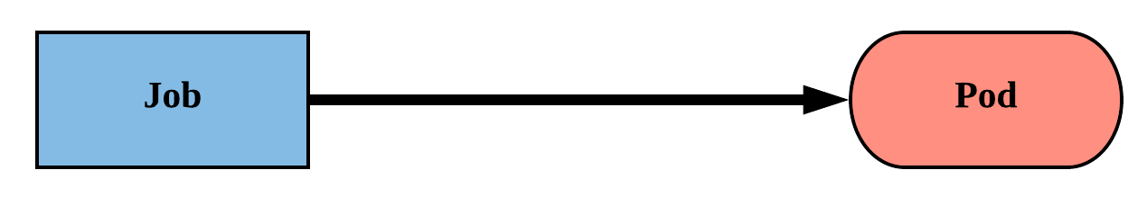
Job
Job controller ensures one or more pods are executed and successfully terminate.
Will continue to try and execute the job until it satisfies the completion and/or parallelism condition.
Pods are NOT cleaned up until the job itself is deleted.*
Notes:
A job workload is run through a job controller. The job controller, put simply, makes sure that things complete successfully.
The controller is dumb, and attempts to achieve its defined requirements via parallelism and completion fields.
Another key thing is that pods aren’t removed once a job completes. They do get cleaned up after a certain defined threshold.

Slide 122
Job
backoffLimit: The number of failures before the job itself is considered failed.
completions: The total number of successful completions desired.
parallelism: How many instances of the pod can be run concurrently.
spec.template.spec.restartPolicy:Jobs only support a restartPolicy of type Never or OnFailure.
apiVersion: batch/v1
kind: Job
metadata:
name: job-example
spec:
backoffLimit: 4
completions: 4
parallelism: 2
template:
spec:
restartPolicy: Never
<pod-template>

Slide 123
Job
apiVersion: batch/v1
kind: Job
metadata:
name: job-example
spec:
backoffLimit: 4
completions: 4
parallelism: 2
template:
spec:
containers:
- name: hello
image: alpine:latest
command: ["/bin/sh", "-c"]
args: ["echo hello from $HOSTNAME!"]
restartPolicy: Never
$ kubectl describe job job-example
Name: job-example
Namespace: default
Selector: controller-uid=19d122f4-1576-11e8-a4e2-080027a3682b
Labels: controller-uid=19d122f4-1576-11e8-a4e2-080027a3682b
job-name=job-example
Annotations: <none>
Parallelism: 2
Completions: 4
Start Time: Mon, 19 Feb 2018 08:09:21 -0500
Pods Statuses: 0 Running / 4 Succeeded / 0 Failed
Pod Template:
Labels: controller-uid=19d122f4-1576-11e8-a4e2-080027a3682b
job-name=job-example
Containers:
hello:
Image: alpine:latest
Port: <none>
Command:
/bin/sh
-c
Args:
echo hello from $HOSTNAME!
Environment: <none>
Mounts: <none>
Volumes: <none>
Events:
Type Reason Age From Message
---- ------ ---- ---- -------
Normal SuccessfulCreate 52m job-controller Created pod: job-example-v5fvq
Normal SuccessfulCreate 52m job-controller Created pod: job-example-hknns
Normal SuccessfulCreate 51m job-controller Created pod: job-example-tphkm
Normal SuccessfulCreate 51m job-controller Created pod: job-example-dvxd2
$ kubectl get pods --show-all
NAME READY STATUS RESTARTS AGE
job-example-dvxd2 0/1 Completed 0 51m
job-example-hknns 0/1 Completed 0 52m
job-example-tphkm 0/1 Completed 0 51m
job-example-v5fvq 0/1 Completed 0 52m
Notes:
controller-uid is added as a label to the generated pods
Describe the behavior of backoffLimit, completions, and parallelism.
Note restartPolicy

Slide 124
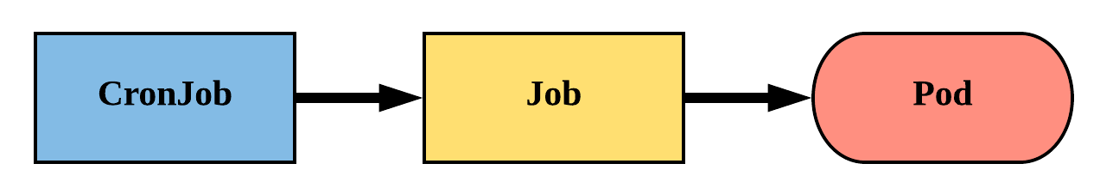
CronJob
An extension of the Job Controller, it provides a method of executing jobs on a cron-like schedule.
CronJobs within Kubernetes use UTC ONLY.

Slide 125
CronJob
schedule: The cron schedule for the job.
successfulJobHistoryLimit: The number of successful jobs to retain.
failedJobHistoryLimit: The number of failed jobs to retain.
apiVersion: batch/v1beta1
kind: CronJob
metadata:
name: cronjob-example
spec:
schedule: "*/1 * * * *"
successfulJobsHistoryLimit: 3
failedJobsHistoryLimit: 1
jobTemplate:
spec:
completions: 4
parallelism: 2
template:
<pod template>

Slide 126
CronJob
apiVersion: batch/v1beta1
kind: CronJob
metadata:
name: cronjob-example
spec:
schedule: "*/1 * * * *"
successfulJobsHistoryLimit: 3
failedJobsHistoryLimit: 1
jobTemplate:
spec:
completions: 4
parallelism: 2
template:
spec:
containers:
- name: hello
image: alpine:latest
command: ["/bin/sh", "-c"]
args: ["echo hello from $HOSTNAME!"]
restartPolicy: Never
$ kubectl describe cronjob cronjob-example
Name: cronjob-example
Namespace: default
Labels: <none>
Annotations: <none>
Schedule: */1 * * * *
Concurrency Policy: Allow
Suspend: False
Starting Deadline Seconds: <unset>
Selector: <unset>
Parallelism: 2
Completions: 4
Pod Template:
Labels: <none>
Containers:
hello:
Image: alpine:latest
Port: <none>
Command:
/bin/sh
-c
Args:
echo hello from $HOSTNAME!
Environment: <none>
Mounts: <none>
Volumes: <none>
Last Schedule Time: Mon, 19 Feb 2018 09:54:00 -0500
Active Jobs: cronjob-example-1519052040
Events:
Type Reason Age From Message
---- ------ ---- ---- -------
Normal SuccessfulCreate 3m cronjob-controller Created job cronjob-example-1519051860
Normal SawCompletedJob 2m cronjob-controller Saw completed job: cronjob-example-1519051860
Normal SuccessfulCreate 2m cronjob-controller Created job cronjob-example-1519051920
Normal SawCompletedJob 1m cronjob-controller Saw completed job: cronjob-example-1519051920
Normal SuccessfulCreate 1m cronjob-controller Created job cronjob-example-1519051980
$ kubectl get jobs
NAME DESIRED SUCCESSFUL AGE
cronjob-example-1519053240 4 4 2m
cronjob-example-1519053300 4 4 1m
cronjob-example-1519053360 4 4 26s
Notes:
Note successfulJobsHistoryLImit and failedJobsHistoryLimit
Oh hey a jobTemplate.

Slide 127
Using Workloads
Lab - github.com/mrbobbytables/k8s-intro-tutorials/blob/master/workloads

Slide 128
Volumes
Persistent Volumes
Persistent Volume Claims
StorageClass
Storage
Concepts and Resources
Notes:
Bob - v,sc
Jeff - pv,pvc

Slide 129
Storage
Pods by themselves are useful, but many workloads require exchanging data between containers, or persisting some form of data.
For this we have Volumes, PersistentVolumes, PersistentVolumeClaims, and StorageClasses.
Notes:
Storage is one of those things that does tend to confuse people with all the various levels of abstractions
4 ‘types’ of storage
Volumes
Persistent Volumes
Persistent Volume Claims
Storage Classes

Slide 130
Volumes
Storage that is tied to the Pod’s Lifecycle.
A pod can have one or more types of volumes attached to it.
Can be consumed by any of the containers within the pod.
Survive Pod restarts; however their durability beyond that is dependent on the Volume Type.
Notes:
A Volume is defined in the pod Spec and tied to its lifecycle
This means it survives a Pod restart, but what happens to it when the pod is deleted is up to the volume type
volumes themselves can be actually be attached to more than one container within the Pod
very common to share storage between containers within the pod
web server
pre-process data
socket files
logs

Slide 131
Volume Types
awsElasticBlockStore
azureDisk
azureFile
cephfs
configMap
csi
downwardAPI
emptyDir
fc (fibre channel)
flocker
gcePersistentDisk
gitRepo
glusterfs
hostPath
iscsi
local
nfs
persistentVolumeClaim
projected
portworxVolume
quobyte
rbd
scaleIO
secret
storageos
vsphereVolume
Persistent Volume Supported. (ones in blue)
Notes:
Current list of in-tree volume types supported, with more being added through the “Container Storage Interface”
essentially storage plugin system supported by multiple container orchestration engines (k8s and mesos)
The ones in blue support persisting beyond a pod’s lifecycle, but generally are not mounted directly except through a persistent volume claim
emptyDir is common for scratch space between pods
configMap, secret, downward API, and projected are all used for injecting information stored within Kubernetes directly into the Pod

Slide 132
Volumes
volumes: A list of volume objects to be attached to the Pod. Every object within the list must have it’s own unique name.
volumeMounts: A container specific list referencing the Pod volumes by name, along with their desired mountPath.
apiVersion: v1
kind: Pod
metadata:
name: volume-example
spec:
containers:
- name: nginx
image: nginx:stable-alpine
volumeMounts:
- name: html
mountPath: /usr/share/nginx/html
ReadOnly: true
- name: content
image: alpine:latest
command: ["/bin/sh", "-c"]
args:
- while true; do
date >> /html/index.html;
sleep 5;
done
volumeMounts:
- name: html
mountPath: /html
volumes:
- name: html
emptyDir: {}
Notes:
2 Major components with volumes in a Pod Spec:
volumes is on the same ‘level’ as containers within the Pod Spec
volumeMounts are part of each container’s definition

Slide 133
Volumes
volumes: A list of volume objects to be attached to the Pod. Every object within the list must have it’s own unique name.
volumeMounts: A container specific list referencing the Pod volumes by name, along with their desired mountPath.
apiVersion: v1
kind: Pod
metadata:
name: volume-example
spec:
containers:
- name: nginx
image: nginx:stable-alpine
volumeMounts:
- name: html
mountPath: /usr/share/nginx/html
ReadOnly: true
- name: content
image: alpine:latest
command: ["/bin/sh", "-c"]
args:
- while true; do
date >> /html/index.html;
sleep 5;
done
volumeMounts:
- name: html
mountPath: /html
volumes:
- name: html
emptyDir: {}
Notes:
Volumes is a list of every volume type you want to attach to the Pod
Each volume will have its own volume type specific parameters and a name
Using the name is how we reference mounting that storage within a container

Slide 134
Volumes
volumes: A list of volume objects to be attached to the Pod. Every object within the list must have it’s own unique name.
volumeMounts: A container specific list referencing the Pod volumes by name, along with their desired mountPath.
apiVersion: v1
kind: Pod
metadata:
name: volume-example
spec:
containers:
- name: nginx
image: nginx:stable-alpine
volumeMounts:
- name: html
mountPath: /usr/share/nginx/html
ReadOnly: true
- name: content
image: alpine:latest
command: ["/bin/sh", "-c"]
args:
- while true; do
date >> /html/index.html;
sleep 5;
done
volumeMounts:
- name: html
mountPath: /html
volumes:
- name: html
emptyDir: {}
Notes:
volumeMounts is an attribute within each container in your Pod
they reference the volume name and supply the mountPath
It may have other available options depending on the volume type
e.g. mount read only

Slide 135
Persistent Volumes
A PersistentVolume (PV) represents a storage resource.
PVs are a cluster wide resource linked to a backing storage provider: NFS, GCEPersistentDisk, Replicated Block Device (RBD) etc.
Generally provisioned by an administrator.
Their lifecycle is handled independently from a pod
CANNOT be attached to a Pod directly. Relies on a PersistentVolumeClaim
Notes:
PVs are k8s objects that represent underlying storage.
They don’t belong to any namespace, they are a global resource.
As such users aren’t usually the ones creating PVs, that’s left up to admins.
The way a user consumes a PV is by creating a PVC.
Google Cloud Engine Persistent Disk, Remote Block Device or NFS etc.

Slide 136
PersistentVolumeClaims
A PersistentVolumeClaim (PVC) is a namespaced request for storage.
Satisfies a set of requirements instead of mapping to a storage resource directly.
Ensures that an application’s ‘claim’ for storage is portable across numerous backends or providers.
Notes:
Unlike a PV, a PVC is based within a namespace (with the pod)
It is a one-to-one mapping of a user claim to a global storage offer.
A user can define specific requirements for their PVC so it gets matched with a specific PV.

Slide 137
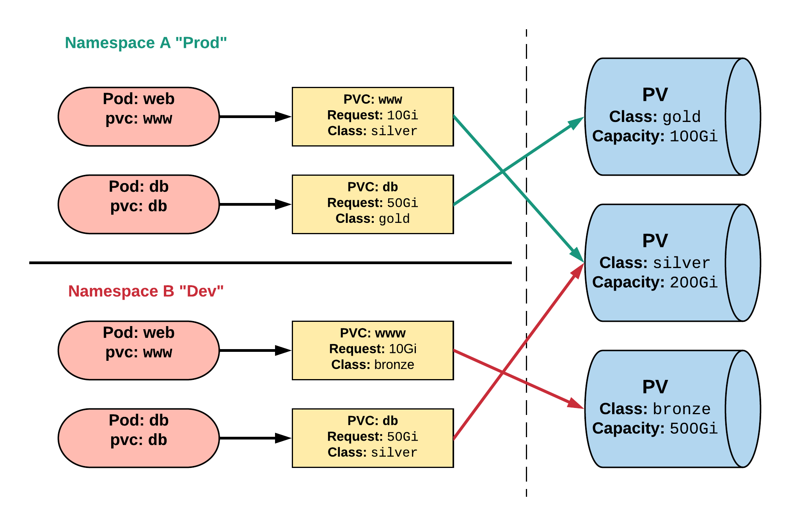
Persistent Volumes and Claims
Cluster Users
Cluster Admins
Notes:
PVCs can be named the same to make things consistent but point to different storage classes
In this example we have a dev and prod namespace.
These PVCs are named the same, but reside within different namespaces and request different classes of storage.

Slide 138
PersistentVolume
capacity.storage: The total amount of available storage.
volumeMode: The type of volume, this can be either Filesystem or Block.
accessModes: A list of the supported methods of accessing the volume. Options include:
ReadWriteOnce
ReadOnlyMany
ReadWriteMany
apiVersion: v1
kind: PersistentVolume
metadata:
name: nfsserver
spec:
capacity:
storage: 50Gi
volumeMode: Filesystem
accessModes:
- ReadWriteOnce
- ReadWriteMany
persistentVolumeReclaimPolicy: Delete
storageClassName: slow mountOptions:
- hard
- nfsvers=4.1
nfs:
path: /exports
server: 172.22.0.42
Notes:
For a PV, you define the capacity, whether you want a filesystem or a block device, and the access mode.
A word on accessModes:
RWO means only a single pod will be able to (through a PVC) mount this.
ROM means many pods can mount this, but none can write.
RWM means, well, many pods can mount and write.

Slide 139
PersistentVolume
persistentVolumeReclaimPolicy: The behaviour for PVC’s that have been deleted. Options include:
Retain - manual clean-up
Delete - storage asset deleted by provider.
storageClassName: Optional name of the storage class that PVC’s can reference. If provided, ONLY PVC’s referencing the name consume use it.
mountOptions: Optional mount options for the PV.
apiVersion: v1
kind: PersistentVolume
metadata:
name: nfsserver
spec:
capacity:
storage: 50Gi
volumeMode: Filesystem
accessModes:
- ReadWriteOnce
- ReadWriteMany
persistentVolumeReclaimPolicy: Delete
storageClassName: slow mountOptions:
- hard
- nfsvers=4.1
nfs:
path: /exports
server: 172.22.0.42
Notes:
Additionally, you need to specify your reclaim policy. If a PVC goes away, should the PV clean itself up or do you want manual intervention? Manual intervention is certainly safer, but everyone's use case may vary.
You can define your storageClass here. For example, if this PV attaches to super fast storage, you might call the storageClass “superfast” and then ONLY PVCs that target it can attach to it.
Finally, you define mount options. These vary depending on your volumeType, but think of it like the same options you’d put in FSTAB or a mount command. Just recognize this is an array.

Slide 140
PersistentVolumeClaim
accessModes: The selected method of accessing the storage. This MUST be a subset of what is defined on the target PV or Storage Class.
ReadWriteOnce
ReadOnlyMany
ReadWriteMany
resources.requests.storage: The desired amount of storage for the claim
storageClassName: The name of the desired Storage Class
kind: PersistentVolumeClaim
apiVersion: v1
metadata:
name: pvc-sc-example
spec:
accessModes:
- ReadWriteOnce
resources:
requests:
storage: 1Gi
storageClassName: slow
Notes:
As with the PV, you define your accessModes for your PVC. A PV and a PVC match through their accessModes.
Likewise, you request how much storage your PVC will require. Finally, you can specify what className you require.
A lot of this can be arbitrary and highly dependent on your environment.

Slide 141
PVs and PVCs with Selectors
kind: PersistentVolume
apiVersion: v1
metadata:
name: pv-selector-example
labels:
type: hostpath
spec:
capacity:
storage: 2Gi
accessModes:
- ReadWriteMany
hostPath:
path: "/mnt/data"
kind: PersistentVolumeClaim
apiVersion: v1
metadata:
name: pvc-selector-example
spec:
accessModes:
- ReadWriteMany
resources:
requests:
storage: 1Gi
selector:
matchLabels:
type: hostpath
Notes:
This example defines a PV with 2Gi of space and a label.
The PV is using the hostPath volume type, and thus they have a label of “type: hostpath”
The PVC is looking for 1Gi of storage and is looking for a PV with a label of “type: hostpath”
Next slide: match on labels

Slide 142
PVs and PVCs with Selectors
kind: PersistentVolume
apiVersion: v1
metadata:
name: pv-selector-example
labels:
type: hostpath
spec:
capacity:
storage: 2Gi
accessModes:
- ReadWriteMany
hostPath:
path: "/mnt/data"
kind: PersistentVolumeClaim
apiVersion: v1
metadata:
name: pvc-selector-example
spec:
accessModes:
- ReadWriteMany
resources:
requests:
storage: 1Gi
selector:
matchLabels:
type: hostpath
Notes:
They will match and bind because the labels match, the access modes match, and the PVC storage capacity is <= PV storage capacity

Slide 143
PV Phases
Available
PV is ready and available to be consumed.
Bound
The PV has been bound to a claim.
Released
The binding PVC has been deleted, and the PV is pending reclamation.
Failed
An error has been encountered attempting to reclaim the PV.
Notes:
If you get or describe a PV, you will see that they have several different states.
The diagram has a pretty good explanation but it warrants going over.
Available - The PV is ready and available
Bound - The PV has been bound to a PVC and is not available.
Released - The PVC no longer exists. The PV is in a state that (depending on reclaimPolicy) requires manual intervention
Failed - For some reason, Kubernetes could not reclaim the PV from the stale or deleted PVC

Slide 144
StorageClass
Storage classes are an abstraction on top of an external storage resource (PV)
Work hand-in-hand with the external storage system to enable dynamic provisioning of storage
Eliminates the need for the cluster admin to pre-provision a PV
Notes:
PV’s and PVCs work great together, but still require some manual provisioning under the hood.
What if we could do all that dynamically? Well, you can with StorageClasses
Act as an abstraction on top of a external storage resource that has dynamic provisioning capability
usually the cloud providers, but others work like ceph

Slide 145
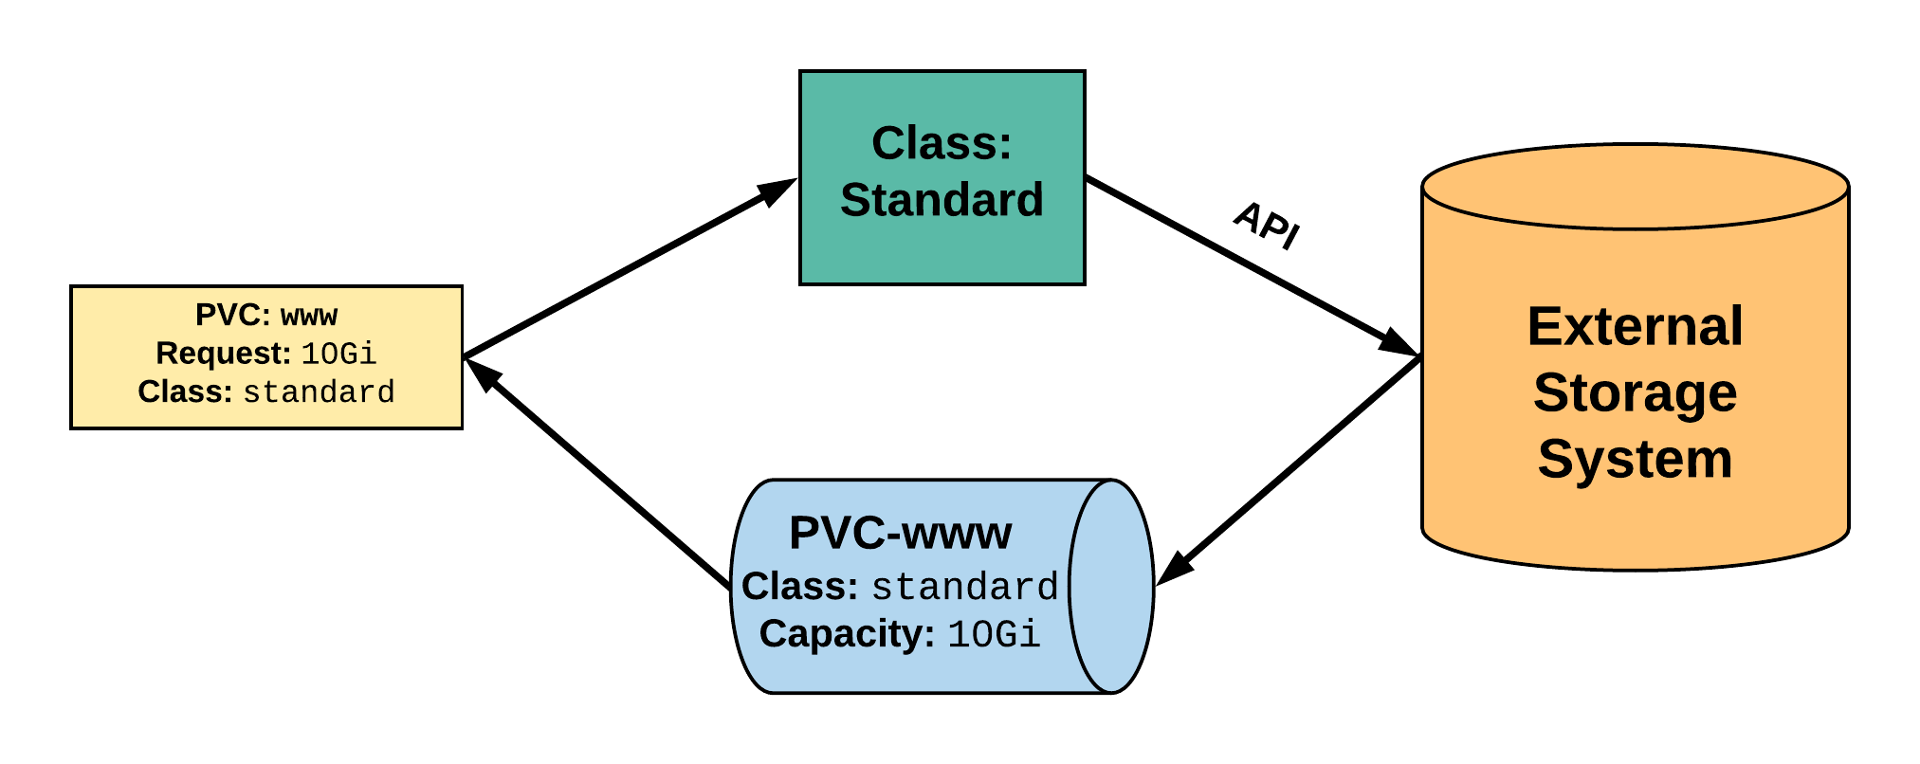
StorageClass
2. StorageClass provisions request through API with external storage system.
1. PVC makes a request of the StorageClass.
uid: 9df65c6e-1a69-11e8-ae10-080027a3682b
4. provisioned PV is bound to requesting PVC.
3. External storage system creates a PV strictly satisfying the PVC request.
pv: pvc-9df65c6e-1a69-11e8-ae10-080027a3682b
Notes:
A PVC is created with a storage request and supplies the StorageClass ‘standard’
The storageClass ‘standard’ is configured with some information to connect and interact with the API of an external storage provider
The external storage provider creates a PV that strictly satisfies the PVC request. Really, it means it’s the same size as the request
The PV will be named pvc-<uid of the pvc>
The PV is then bound to the requesting PVC

Slide 146
StorageClass
provisioner: Defines the ‘driver’ to be used for provisioning of the external storage.
parameters: A hash of the various configuration parameters for the provisioner.
reclaimPolicy: The behaviour for the backing storage when the PVC is deleted.
Retain - manual clean-up
Delete - storage asset deleted by provider
kind: StorageClass
apiVersion: storage.k8s.io/v1
metadata:
name: standard
provisioner: kubernetes.io/gce-pd
parameters:
type: pd-standard
zones: us-central1-a, us-central1-b
reclaimPolicy: Delete
Notes:
A storage class is really defined by its provisioner.
Each provisioner will have a slew of different parameters that are tied to the specific storage system it’s talking to.
Lastly is the reclaimPolicy which tells the external storage system what to do when the associate PVC is deleted.

Slide 147
Available StorageClasses
AWSElasticBlockStore
AzureFile
AzureDisk
CephFS
Cinder
FC
Flocker
GCEPersistentDisk
Glusterfs
iSCSI
Quobyte
NFS
RBD
VsphereVolume
PortworxVolume
ScaleIO
StorageOS
Local
Internal Provisioner
Notes:
A list of current StorageClasses
More are supported through CSI plugin

Slide 148
Working with Volumes
Lab - github.com/mrbobbytables/k8s-intro-tutorials/blob/master/storage

Slide 149
ConfigMap
Secret
Configuration
Concepts and Resources

Slide 150
Configuration
Kubernetes has an integrated pattern for decoupling configuration from application or container.
This pattern makes use of two Kubernetes components: ConfigMaps and Secrets.
Notes:
There are instances in your application where you want to be able to store runtime-specific information.
Things like connection info, SSL certs, certain flags that you will inevitably change over time.
The Kubernetes takes that into account and has a solution with ConfigMaps and Secrets.
ConfigMaps and Secrets are kind of like Volumes, as you’ll see.

Slide 151
ConfigMap
Externalized data stored within kubernetes.
Can be referenced through several different means:
environment variable
a command line argument (via env var)
injected as a file into a volume mount
Can be created from a manifest, literals, directories, or files directly.
Notes:
Configmap data is stored “outside” of the cluster (in etcd)
They are insanely versatile. You can inject them as environment variables at runtime, as a command arg, or as a file or folder via a volume mount.
They can also be created in a multitude of ways.

Slide 152
ConfigMap
data: Contains key-value pairs of ConfigMap contents.
apiVersion: v1
kind: ConfigMap
metadata:
name: manifest-example
data:
state: Michigan
city: Ann Arbor
content: |
Look at this,
its multiline!
Notes:
This is a pretty basic example of a configmap.
It has three different keys and values.

Slide 153
ConfigMap Example
All produce a ConfigMap with the same content!
apiVersion: v1
kind: ConfigMap
metadata:
name: manifest-example
data:
city: Ann Arbor
state: Michigan
$ kubectl create configmap literal-example \
> --from-literal="city=Ann Arbor" --from-literal=state=Michigan
configmap “literal-example” created
$ cat info/city
Ann Arbor
$ cat info/state
Michigan
$ kubectl create configmap dir-example --from-file=cm/
configmap "dir-example" created
$ cat info/city
Ann Arbor
$ cat info/state
Michigan
$ kubectl create configmap file-example --from-file=cm/city --from-file=cm/state
configmap "file-example" created
Notes:
Like I said there are a lot of different ways to create a configmap and all yield the same result.

Slide 154
ConfigMap Example
All produce a ConfigMap with the same content!
apiVersion: v1
kind: ConfigMap
metadata:
name: manifest-example
data:
city: Ann Arbor
state: Michigan
$ kubectl create configmap literal-example \
> --from-literal="city=Ann Arbor" --from-literal=state=Michigan
configmap “literal-example” created
$ cat info/city
Ann Arbor
$ cat info/state
Michigan
$ kubectl create configmap dir-example --from-file=cm/
configmap "dir-example" created
$ cat info/city
Ann Arbor
$ cat info/state
Michigan
$ kubectl create configmap file-example --from-file=cm/city --from-file=cm/state
configmap "file-example" created
Notes:
You can use kubectl and simply pass it strings for everything

Slide 155
ConfigMap Example
All produce a ConfigMap with the same content!
apiVersion: v1
kind: ConfigMap
metadata:
name: manifest-example
data:
city: Ann Arbor
state: Michigan
$ kubectl create configmap literal-example \
> --from-literal="city=Ann Arbor" --from-literal=state=Michigan
configmap “literal-example” created
$ cat info/city
Ann Arbor
$ cat info/state
Michigan
$ kubectl create configmap dir-example --from-file=cm/
configmap "dir-example" created
$ cat info/city
Ann Arbor
$ cat info/state
Michigan
$ kubectl create configmap file-example --from-file=cm/city --from-file=cm/state
configmap "file-example" created
Notes:
You can pass it a folder and it will be smart and map the files to keys within the configmap

Slide 156
ConfigMap Example
All produce a ConfigMap with the same content!
apiVersion: v1
kind: ConfigMap
metadata:
name: manifest-example
data:
city: Ann Arbor
state: Michigan
$ kubectl create configmap literal-example \
> --from-literal="city=Ann Arbor" --from-literal=state=Michigan
configmap “literal-example” created
$ cat info/city
Ann Arbor
$ cat info/state
Michigan
$ kubectl create configmap dir-example --from-file=cm/
configmap "dir-example" created
$ cat info/city
Ann Arbor
$ cat info/state
Michigan
$ kubectl create configmap file-example --from-file=cm/city --from-file=cm/state
configmap "file-example" created
Notes:
Or you can pass the files individually.

Slide 157
Secret
Functionally identical to a ConfigMap.
Stored as base64 encoded content.
Encrypted at rest within etcd (if configured!).
Ideal for username/passwords, certificates or other sensitive information that should not be stored in a container.
Can be created from a manifest, literals, directories, or from files directly.
Notes:
Secrets for the most part are functionally identical to ConfigMaps with a few small key differences
stored as base64 encoded content
encrypted if configured
great for user/pass or certs
and can be created the same way as configmaps

Slide 158
Secret
type: There are three different types of secrets within Kubernetes:
docker-registry - credentials used to authenticate to a container registry
generic/Opaque - literal values from different sources
tls - a certificate based secret
data: Contains key-value pairs of base64 encoded content.
apiVersion: v1
kind: Secret
metadata:
name: manifest-secret
type: Opaque
data:
username: ZXhhbXBsZQ==
password: bXlwYXNzd29yZA==
Notes:
Looks very similar to ConfigMap
Now has a type:
docker-registry - used by container runtime to pull images from private registries
generic - just unstructured data
tls - pub/priv keys that can be used both inside a container and out by k8s itself

Slide 159
Secret Example
All produce a Secret with the same content!
apiVersion: v1
kind: Secret
metadata:
name: manifest-example
type: Opaque
data:
username: ZXhhbXBsZQ==
password: bXlwYXNzd29yZA==
$ kubectl create secret generic literal-secret \ > --from-literal=username=example \ > --from-literal=password=mypassword
secret "literal-secret" created
$ cat info/username
example
$ cat info/password
mypassword
$ kubectl create secret generic dir-secret --from-file=secret/
Secret "file-secret" created
$ cat secret/username
example
$ cat secret/password
mypassword
$ kubectl create secret generic file-secret --from-file=secret/username --from-file=secret/password
Secret "file-secret" created
Notes:
Same as ConfigMaps except you now have to tell it what kind of secret (we use generic here)

Slide 160
Secret Example
All produce a Secret with the same content!
apiVersion: v1
kind: Secret
metadata:
name: manifest-example
type: Opaque
data:
username: ZXhhbXBsZQ==
password: bXlwYXNzd29yZA==
$ kubectl create secret generic literal-secret \ > --from-literal=username=example \ > --from-literal=password=mypassword
secret "literal-secret" created
$ cat info/username
example
$ cat info/password
mypassword
$ kubectl create secret generic dir-secret --from-file=secret/
Secret "file-secret" created
$ cat secret/username
example
$ cat secret/password
mypassword
$ kubectl create secret generic file-secret --from-file=secret/username --from-file=secret/password
Secret "file-secret" created
Notes:
From literals

Slide 161
Secret Example
All produce a Secret with the same content!
apiVersion: v1
kind: Secret
metadata:
name: manifest-example
type: Opaque
data:
username: ZXhhbXBsZQ==
password: bXlwYXNzd29yZA==
$ kubectl create secret generic literal-secret \ > --from-literal=username=example \ > --from-literal=password=mypassword
secret "literal-secret" created
$ cat info/username
example
$ cat info/password
mypassword
$ kubectl create secret generic dir-secret --from-file=secret/
Secret "file-secret" created
$ cat secret/username
example
$ cat secret/password
mypassword
$ kubectl create secret generic file-secret --from-file=secret/username --from-file=secret/password
Secret "file-secret" created
Notes:
From a directory

Slide 162
Secret Example
All produce a Secret with the same content!
apiVersion: v1
kind: Secret
metadata:
name: manifest-example
type: Opaque
data:
username: ZXhhbXBsZQ==
password: bXlwYXNzd29yZA==
$ kubectl create secret generic literal-secret \ > --from-literal=username=example \ > --from-literal=password=mypassword
secret "literal-secret" created
$ cat info/username
example
$ cat info/password
mypassword
$ kubectl create secret generic dir-secret --from-file=secret/
Secret "file-secret" created
$ cat secret/username
example
$ cat secret/password
mypassword
$ kubectl create secret generic file-secret --from-file=secret/username --from-file=secret/password
Secret "file-secret" created
Notes:
From individual files

Slide 163
Injecting as Environment Variable
apiVersion: batch/v1
kind: Job
metadata:
name: cm-env-example
spec:
template:
spec:
containers:
- name: mypod
image: alpine:latest
command: [“/bin/sh”, “-c”]
args: [“printenv CITY”]
env:
- name: CITY
valueFrom:
configMapKeyRef:
name: manifest-example
key: city
restartPolicy: Never
apiVersion: batch/v1
kind: Job
metadata:
name: secret-env-example
spec:
template:
spec:
containers:
- name: mypod
image: alpine:latest
command: [“/bin/sh”, “-c”]
args: [“printenv USERNAME”]
env:
- name: USERNAME
valueFrom:
secretKeyRef:
name: manifest-example
key: username
restartPolicy: Never
Notes:
On the left is ConfigMaps, right is Secret
K8s lets you pass all sorts of information into a container, with environment variables being one of them
uses ‘valueFrom’
specify that it comes from a ConfigMap or Secret, give it the cm/secret name and key you want to query

Slide 164
Injecting as Environment Variable
apiVersion: batch/v1
kind: Job
metadata:
name: cm-env-example
spec:
template:
spec:
containers:
- name: mypod
image: alpine:latest
command: [“/bin/sh”, “-c”]
args: [“printenv CITY”]
env:
- name: CITY
valueFrom:
configMapKeyRef:
name: manifest-example
key: city
restartPolicy: Never
apiVersion: batch/v1
kind: Job
metadata:
name: secret-env-example
spec:
template:
spec:
containers:
- name: mypod
image: alpine:latest
command: [“/bin/sh”, “-c”]
args: [“printenv USERNAME”]
env:
- name: USERNAME
valueFrom:
secretKeyRef:
name: manifest-example
key: username
restartPolicy: Never
Notes:
Can then access it just as you would any other env var

Slide 165
Injecting in a Command
apiVersion: batch/v1
kind: Job
metadata:
name: cm-cmd-example
spec:
template:
spec:
containers:
- name: mypod
image: alpine:latest
command: [“/bin/sh”, “-c”]
args: [“echo Hello ${CITY}!”]
env:
- name: CITY
valueFrom:
configMapKeyRef:
name: manifest-example
key: city
restartPolicy: Never
apiVersion: batch/v1
kind: Job
metadata:
name: secret-cmd-example
spec:
template:
spec:
containers:
- name: mypod
image: alpine:latest
command: [“/bin/sh”, “-c”]
args: [“echo Hello ${USERNAME}!”]
env:
- name: USERNAME
valueFrom:
secretKeyRef:
name: manifest-example
key: username
restartPolicy: Never
Notes:
Also means it can be used in the command when launching a container
This is the same thing from the last example

Slide 166
Injecting in a Command
apiVersion: batch/v1
kind: Job
metadata:
name: cm-cmd-example
spec:
template:
spec:
containers:
- name: mypod
image: alpine:latest
command: [“/bin/sh”, “-c”]
args: [“echo Hello ${CITY}!”]
env:
- name: CITY
valueFrom:
configMapKeyRef:
name: manifest-example
key: city
restartPolicy: Never
apiVersion: batch/v1
kind: Job
metadata:
name: secret-cmd-example
spec:
template:
spec:
containers:
- name: mypod
image: alpine:latest
command: [“/bin/sh”, “-c”]
args: [“echo Hello ${USERNAME}!”]
env:
- name: USERNAME
valueFrom:
secretKeyRef:
name: manifest-example
key: username
restartPolicy: Never
Notes:
Now instead of printing them off, we just use normal shell expansion to use them

Slide 167
Injecting as a Volume
apiVersion: batch/v1
kind: Job
metadata:
name: cm-vol-example
spec:
template:
spec:
containers:
- name: mypod
image: alpine:latest
command: [“/bin/sh”, “-c”]
args: [“cat /myconfig/city”]
volumeMounts:
- name: config-volume
mountPath: /myconfig
restartPolicy: Never
volumes:
- name: config-volume
configMap:
name: manifest-example
apiVersion: batch/v1
kind: Job
metadata:
name: secret-vol-example
spec:
template:
spec:
containers:
- name: mypod
image: alpine:latest
command: [“/bin/sh”, “-c”]
args: [“cat /mysecret/username”]
volumeMounts:
- name: secret-volume
mountPath: /mysecret
restartPolicy: Never
volumes:
- name: secret-volume
secret:
secretName: manifest-example
Notes:
Last method is actually mounting them as a volume
we specify volume type as a configmap or secret and give it the name

Slide 168
Injecting as a Volume
apiVersion: batch/v1
kind: Job
metadata:
name: cm-vol-example
spec:
template:
spec:
containers:
- name: mypod
image: alpine:latest
command: [“/bin/sh”, “-c”]
args: [“cat /myconfig/city”]
volumeMounts:
- name: config-volume
mountPath: /myconfig
restartPolicy: Never
volumes:
- name: config-volume
configMap:
name: manifest-example
apiVersion: batch/v1
kind: Job
metadata:
name: secret-vol-example
spec:
template:
spec:
containers:
- name: mypod
image: alpine:latest
command: [“/bin/sh”, “-c”]
args: [“cat /mysecret/username”]
volumeMounts:
- name: secret-volume
mountPath: /mysecret
restartPolicy: Never
volumes:
- name: secret-volume
secret:
secretName: manifest-example
Notes:
Within the container itself, we reference it as we would any other volume
we specify the name, and give it a path

Slide 169
Using ConfigMaps
and Secrets
Lab - github.com/mrbobbytables/k8s-intro-tutorials/blob/master/configuration

Slide 170
Putting it all Together
Lab

Slide 171
Where to go From Here

Slide 172
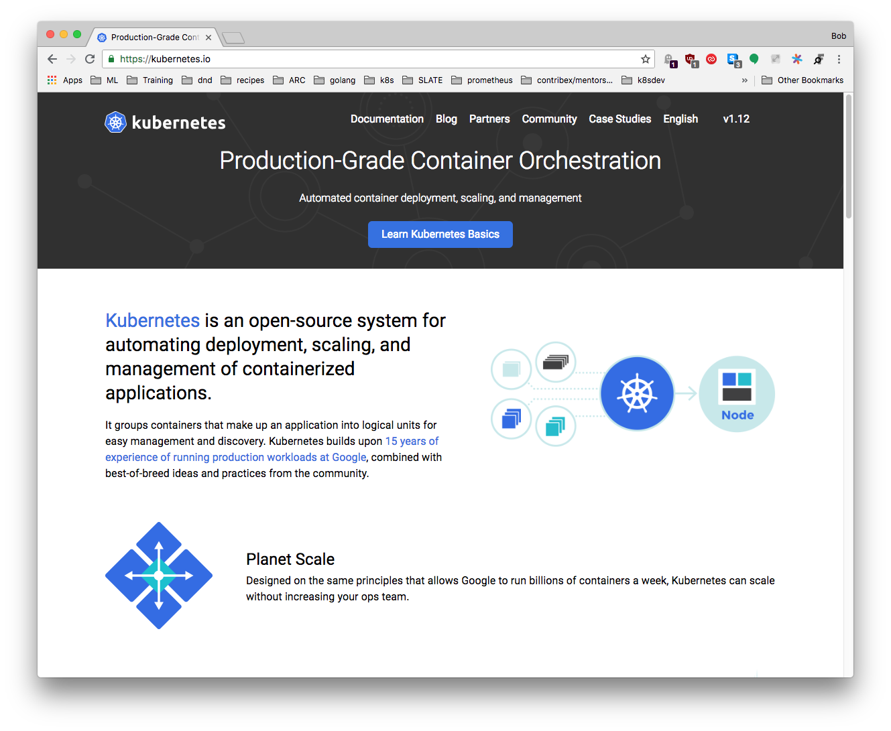
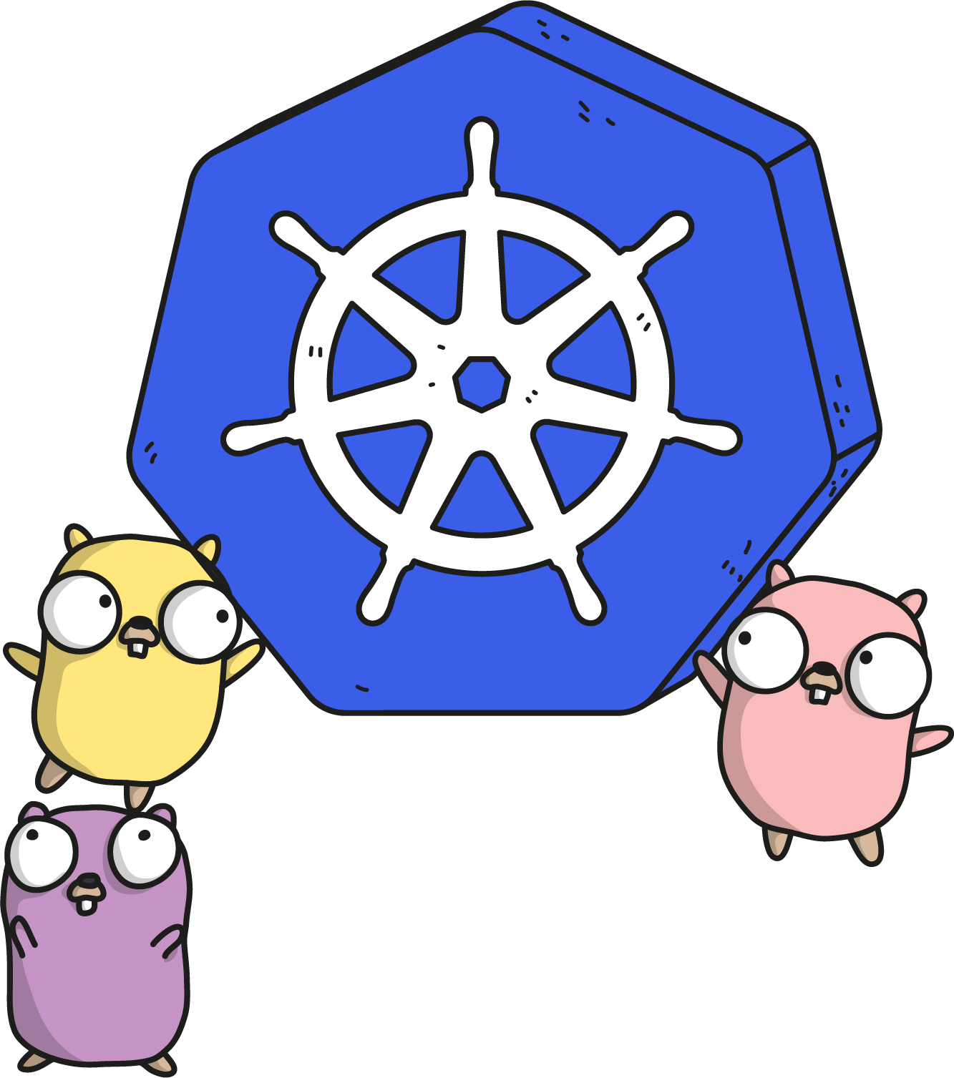
kubernetes.io
Documentation
Examples
API Reference
Notes:
Community driven, constantly updated. The documentation and API references are updated with each release.
There’s an entire group dedicated to this effort.

Slide 173

Slack
Kubernetes
slack.k8s.io
70,000+ users
300+ public channels
CNCF
slack.cncf.io
8,200+ users
70+ public channels
07/2019
Notes:
Two main slacks to be aware of.
The Kubernetes slack has a lot of activity and can be a good place to ask questions or connect with other users.
The CNCF slack isn’t for support, but more for policy and connecting with other places looking to use cloud native technology.
There is also an #academia channel within the CNCF slack that we frequent.

Slide 174


Other Communities
Official Forum https://discuss.kubernetes.io
Subreddit https://reddit.com/r/kubernetes
StackOverflow https://stackoverflow.com/questions/tagged/kubernetes
Notes:
Discuss has taken the place of our old mail group. It is active and many community members watch and answer questions.
There is a Kubernetes subreddit, albeit unofficial, that has some activity.
Finally Kubernetes-tagged Stack Overflow questions are monitored and that activity is even tracked and charted for community engagement.

Slide 175
Meetups
Kubernetes
meetup.com/topics/kubernetes/
850+ groups
380,000+ members
CNCF
meetups.cncf.io
200+ groups
120,000+ members
45+ countries
07/2019
Notes:
Engaging in the community is a great way to stay on top of changes and foster new ideas.
These are a couple good resources to find a meetup near you. We run our own out of Ann Arbor, and hopefully there’s one near you.

Slide 176
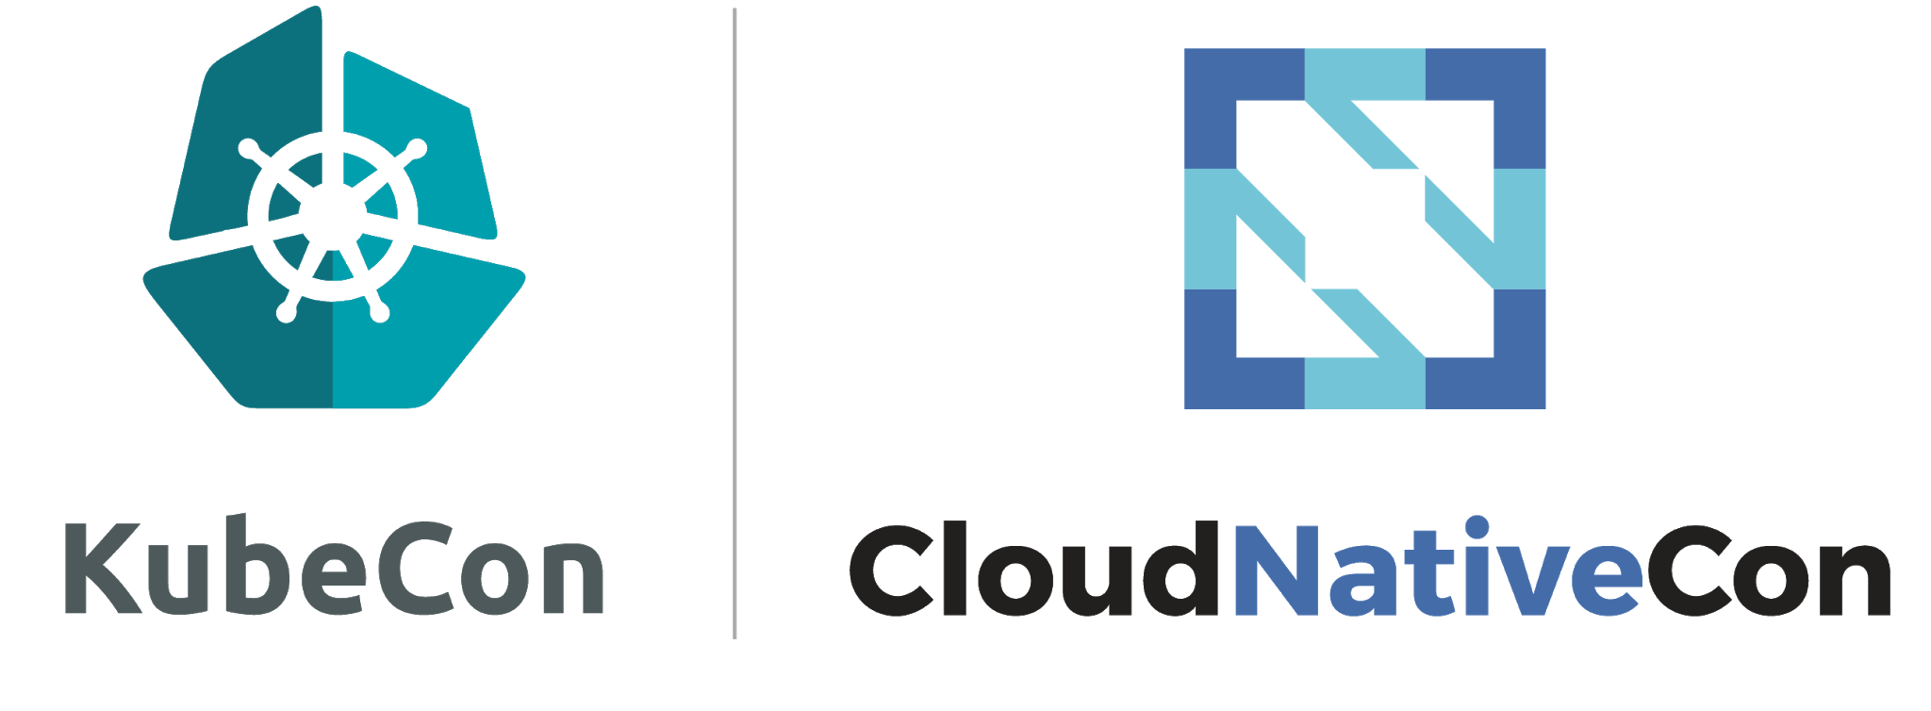
Conventions
China: TBD
Europe: March 30 – April 2, 2020 Amsterdam, Netherlands
North America: November 18 - 21, 2019 San Diego, CA
07/2019
Notes:
In lieu of a meetup, there are several large conventions that focus on showcasing end users of this technology. At KubeCon US we’re looking to host an academic lunch and once things are finalized we’ll get details out.

Slide 177
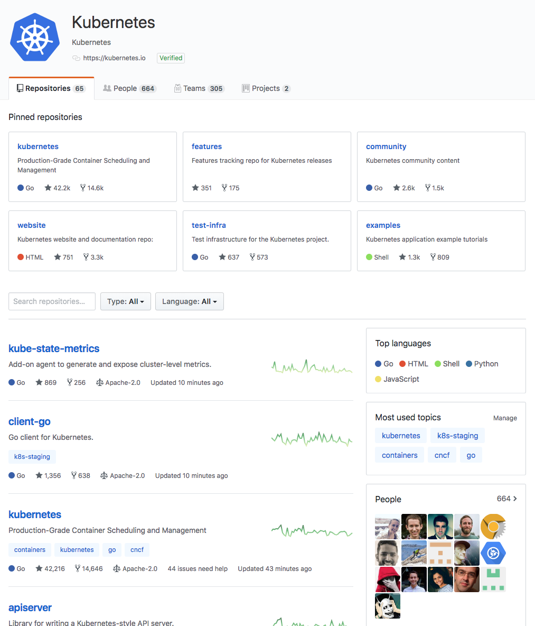
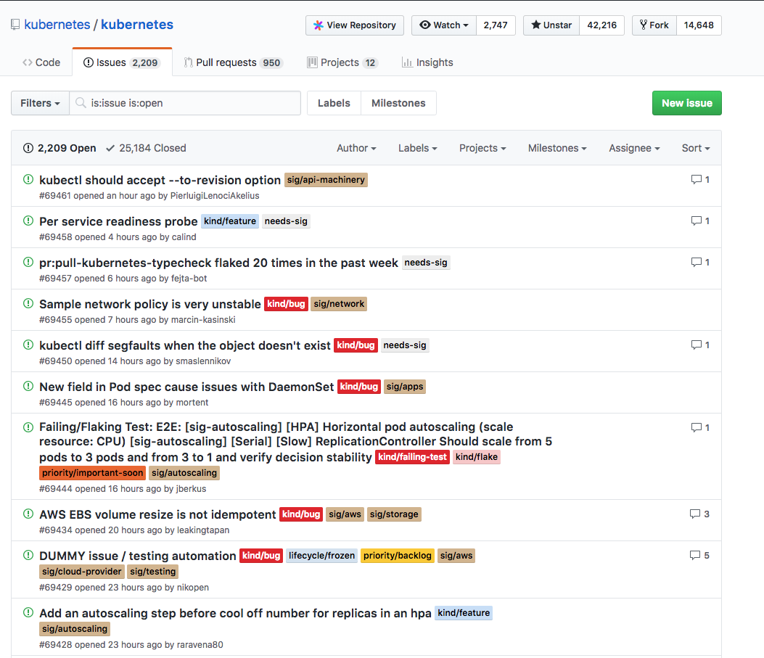
GitHub
Notes:
The last main resource is the Kubernetes GitHub Org and Repos.
This can cause shell shock, but it’s worth noting how things are structured.
There are a lot of different repos within the org because the code base is structured into many sub-projects.
Responsibility for maintaining and organizing code changes falls to various groups

Slide 178
SIGs
Kubernetes components and features are broken down into smaller self-managed communities known as Special Interest Groups (SIG).
Hold weekly public recorded meetings and have their own mailing lists and slack channels.
Notes:
These groups are called Special Interest Groups, or SIGs.
The goal for everything within the project is transparency. All SIGs strive to record and post their meetings and all SIG slacks can be freely joined.

Slide 179
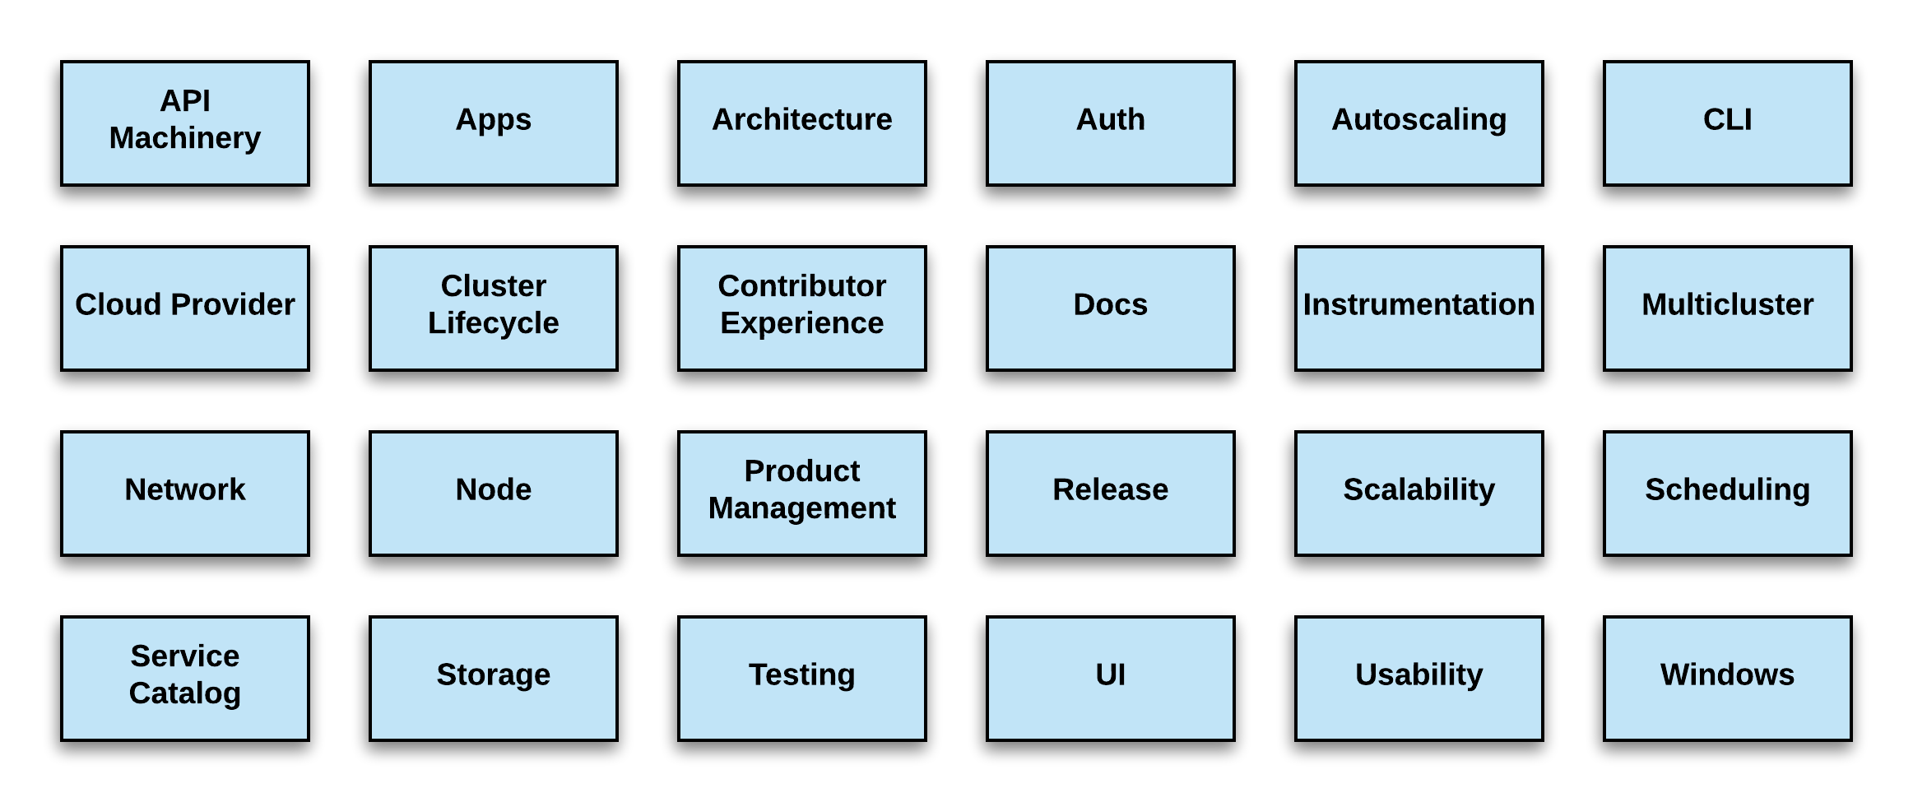
SIG List
https://github.com/kubernetes/community/blob/master/sig-list.md
07/2019
Notes:
There are a lot of them.
Recently the various cloud providers were folded under a single one, sig-cloud-provider
If anyone has questions on what code might fall under which SIG, please ask.
If you ever have to file an Issue on GitHub, knowing this helps immensely as every Issue requires a SIG tag. Think routing a helpdesk ticket to the correct group.

Slide 180
Working Groups
Similar to SIGs, but are topic focused, time-bounded, or act as a focal point for cross-sig coordination.
Hold scheduled publicly recorded meetings in addition to having their own mailing lists and slack channels.
Notes:
In addition to SIGs, there are Working Groups whose main focus is a specific short-term task or an area that spans multiple sigs.
If you were migrating from one data center to another, that might require a large effort across multiple groups within your organization.
A WG is just like that across multiple SIGs.

Slide 181
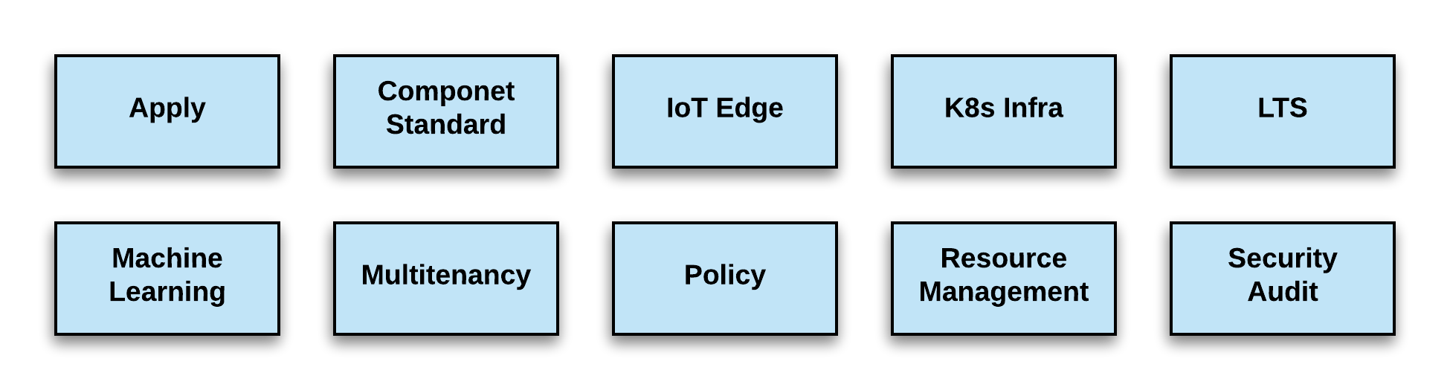
WG List
https://github.com/kubernetes/community/blob/master/sig-list.md
07/2019
Notes:
And here are the current WGs as of this date.
Theres also a newer group type of user-group, but currently only 1 exists: ug-big-data

Slide 182
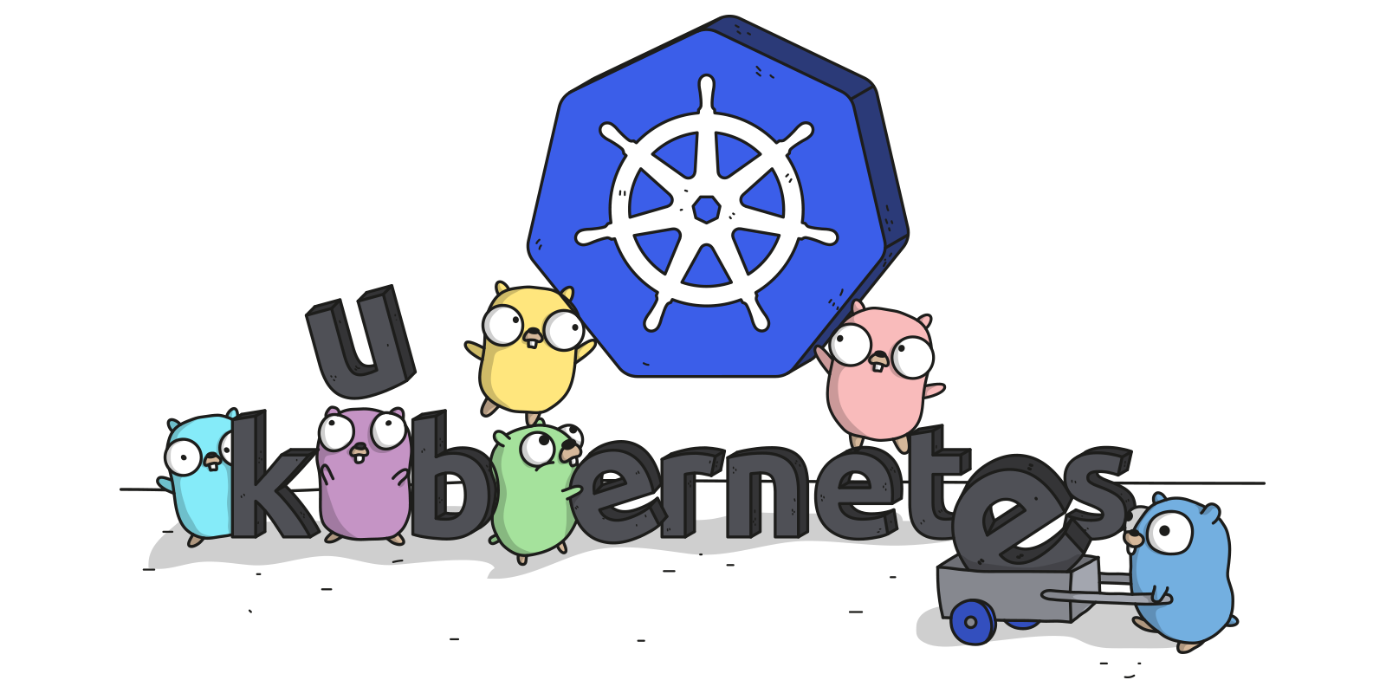
Links
Free Kubernetes Courses https://www.edx.org/
Interactive Kubernetes Tutorials https://www.katacoda.com/courses/kubernetes
Learn Kubernetes the Hard Way https://github.com/kelseyhightower/kubernetes-the-hard-way
Official Kubernetes Youtube Channel https://www.youtube.com/c/KubernetesCommunity
Official CNCF Youtube Channel https://www.youtube.com/c/cloudnativefdn
Track to becoming a CKA/CKAD (Certified Kubernetes Administrator/Application Developer) https://www.cncf.io/certification/expert/
Awesome Kubernetes https://ramitsurana.gitbooks.io/awesome-kubernetes/content/

Slide 183
Questions?

